Slide 1
Partnering with Parents in Jamaican Sign Language (JSL)
Presenters: Zandrea Pitterson, Marissa Phillips and Tisha Ewen-Smith
Authors: Shauna-Kaye McArthur, Tisha Ewen-Smith, Jessica Scott and Hannah Dostal
NATIONAL DEAF EDUCATION CONFERENCE, JUNE 2019

Slide 2
About JAMAICA and the Partnership for Literacy Enhancement for the Deaf Project

Slide 3
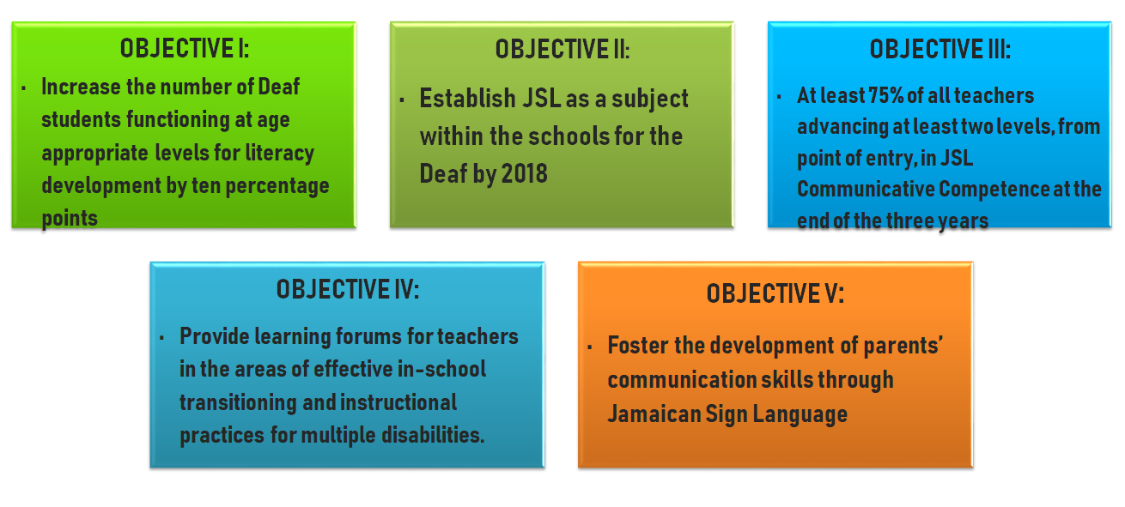
PROJECT GOAL AND OBJECTIVES
GOAL: Increase the literacy level of Deaf children in schools operated by the four major service providers of Deaf Education in Jamaica

Slide 4
Schools for the Deaf in Jamaica

Slide 5
Rationale and Background
In Jamaica, out of a population of about 2.7 million people, approximately 54,000 are Deaf. (The Planning Institute of Jamaica, 2015)
Globally, more than 90 percent of deaf children are born to hearing parents. (National Institute on Deafness and other Communication Disorders, 2016)
Most hearing-families had never interacted with someone who was D/HH until that having a D/HH child. So, to learn Sign Language to communicate with the child becomes integral but also frustrating. (Blose & Joseph, 2017)
Parents’ ability to communicate effectively with their Deaf/Hard-of-Hearing child is of paramount importance. It has greater influence on positive language and academic development. (Hlatyway & Muranda, 2014)

Slide 6
Rationale and Background
Parents having children who are D/HH experience higher stress levels due to the unique demands of raising a D/HH child (Poon & Zaidman-Zait, 2014).
They have to contemplate:
school options;
medical treatment/therapy; and
communication resources and options for their child.
(Poon & Zaidman-Zait, 2014)

Slide 7
The LOCAL Challenge
Parents of students who are Deaf and Hard of Hearing are not proficient JSL Signers.
“Sometimes we talk mouth to mouth, sometimes she reads my lips.”
“She read my lips.”
Parents have difficulty with knowledge about parenting a D/HH child.
“When I found out that my child is deaf...I end up in hospital because I trouble with high blood pressure and she is the older one for my husband and it was very stressing but I am trying to get over it.”
“She reads with her sista.”
“I’ll read with my…deaf child but not sign language.”

Slide 8
Data Collection Methods
Self Reports from Parents (Surveys)
Interviews: Parents, Coordinator and Tutors
Pre/Post Test Measures (Content Based)
Testimonials
Focus Groups
Project Reports

Slide 9
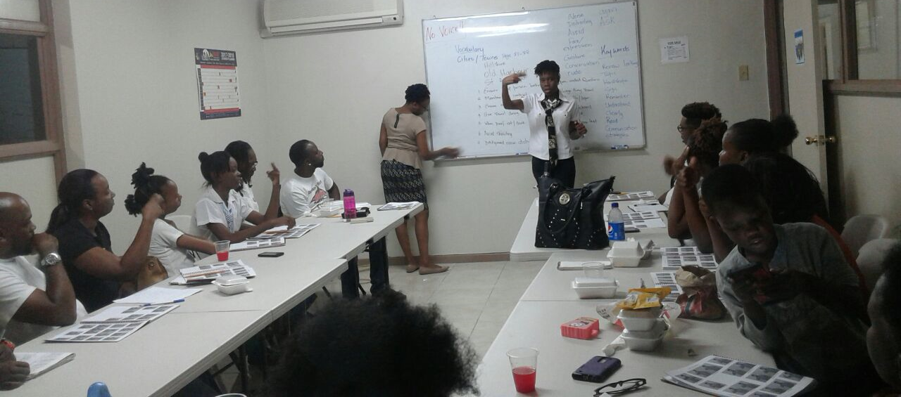
The Sample
Type of Intervention | Males | Females | Total
JSL Classes | 16 (19%) | 70 (81%) | 86
Silent Weekends | 13 (22%) | 46 (78%) | 59
JSL & Enrichment Weekends | 4 (10%) | 35 (90%) | 39
Follow-up Workshop | 3 (10%) | 27 (90%) | 30
Other stakeholders participated in JSL Classes
Child Protection and Family Services Agency (CPFSA)
Churches
Hospital Registrar
Mental Health Nurses
National Child’s Month Committee

Slide 10
Description of Sample
Approximately 100 parents participating at least once in the 1st round of the Weekend Workshops
30% of those who attended first round participated in the follow-up workshop
Only one member of a family was invited (with exceptions)
Majority of parents were hearing (92%), 5% Deaf, 3% Hard of Hearing
Majority (90%) were females - mothers, grandmothers, aunts, sisters.

Slide 11
LOCAL CHALLENGE # 1:
Parents of students who are Deaf and Hard of Hearing are not proficient JSL Signers
“I learn a lot because I learn to spell ma name I learn to spell ma daughter’s name. I can count from one to ten, I learn a lot and I enjoy maself”

Slide 12
Intervention and Measures
Jamaican Sign Language Classes for Parents
Parent Silent Weekends (Voice-Off)
Jamaican Sign Language & Enrichment Weekends for Teacher, Parents and their children/wards
What’s App Parent Groups - JSL Videos
Notes:
JSL Classes:
Once a week intervention for 2.5 hours for 13 weeks
Classes held across parishes to increase the reach
Focus on training parents in JSL (Vocabulary, Linguistics and Deaf Culture)
Delivered solely by trained tutors who are Deaf
Weekly assessments - theory and receptive JSL
Final comprehensive examinations - theory and practical
Pass mark of 50%

Slide 13
Intervention and Measures
What’s App Parent Groups
Parents Day Activities
Shared Reading - HOME VISITS
Parent Training via Parent Silent Weekends (Voice-Off)
Parent Support Groups tacked to Jamaican Sign Language Classes for Parents
Jamaican Sign Language & Enrichment Weekends for Teachers, Parents and their children/wards - Parent Training, Shared Reading and Counselling

Slide 14
Jamaican Sign Language (JSL) and Literacy Enrichment Weekends (Parent Component)
To increase parent involvement in the educational support of deaf/hard of hearing students in Jamaica.
Three-day weekend residential intervention
Teachers, Parents and their children attend with the respective parent-child-teacher components for Grades 1-3 only
Parents are exposed to
JSL and Deaf Culture training (focus on select relevant vocabulary)
Shared Reading Principles
Parenting Skills and Support
Delivered by trained tutors who are Deaf and other professionals within the field of social work and psychology
Pre/Post Tests - JSL Receptive & Multiple Choice
Each parent exposed to one full weekend and a follow-up weekend with between 1-4 months between exposures

Slide 15
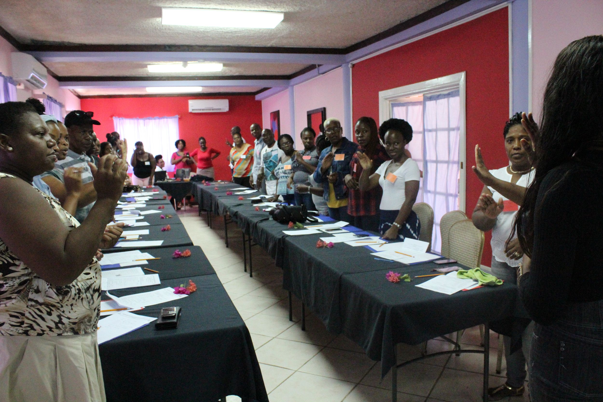
Parent Silent Weekends (Voice-Off)
Three-day weekend residential intervention
Parents are exposed to
JSL and Deaf Culture training
Parenting Skills and Support
Delivered by trained tutors who are Deaf and other professionals
Pre/Post Tests - JSL Receptive & Multiple Choice
Each parent exposed to one full weekend

Slide 16
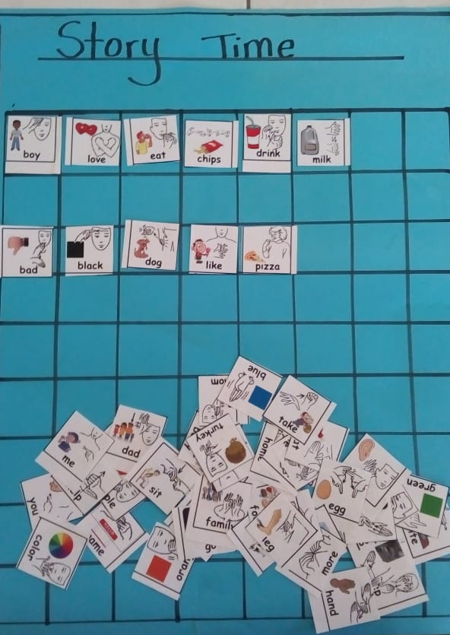
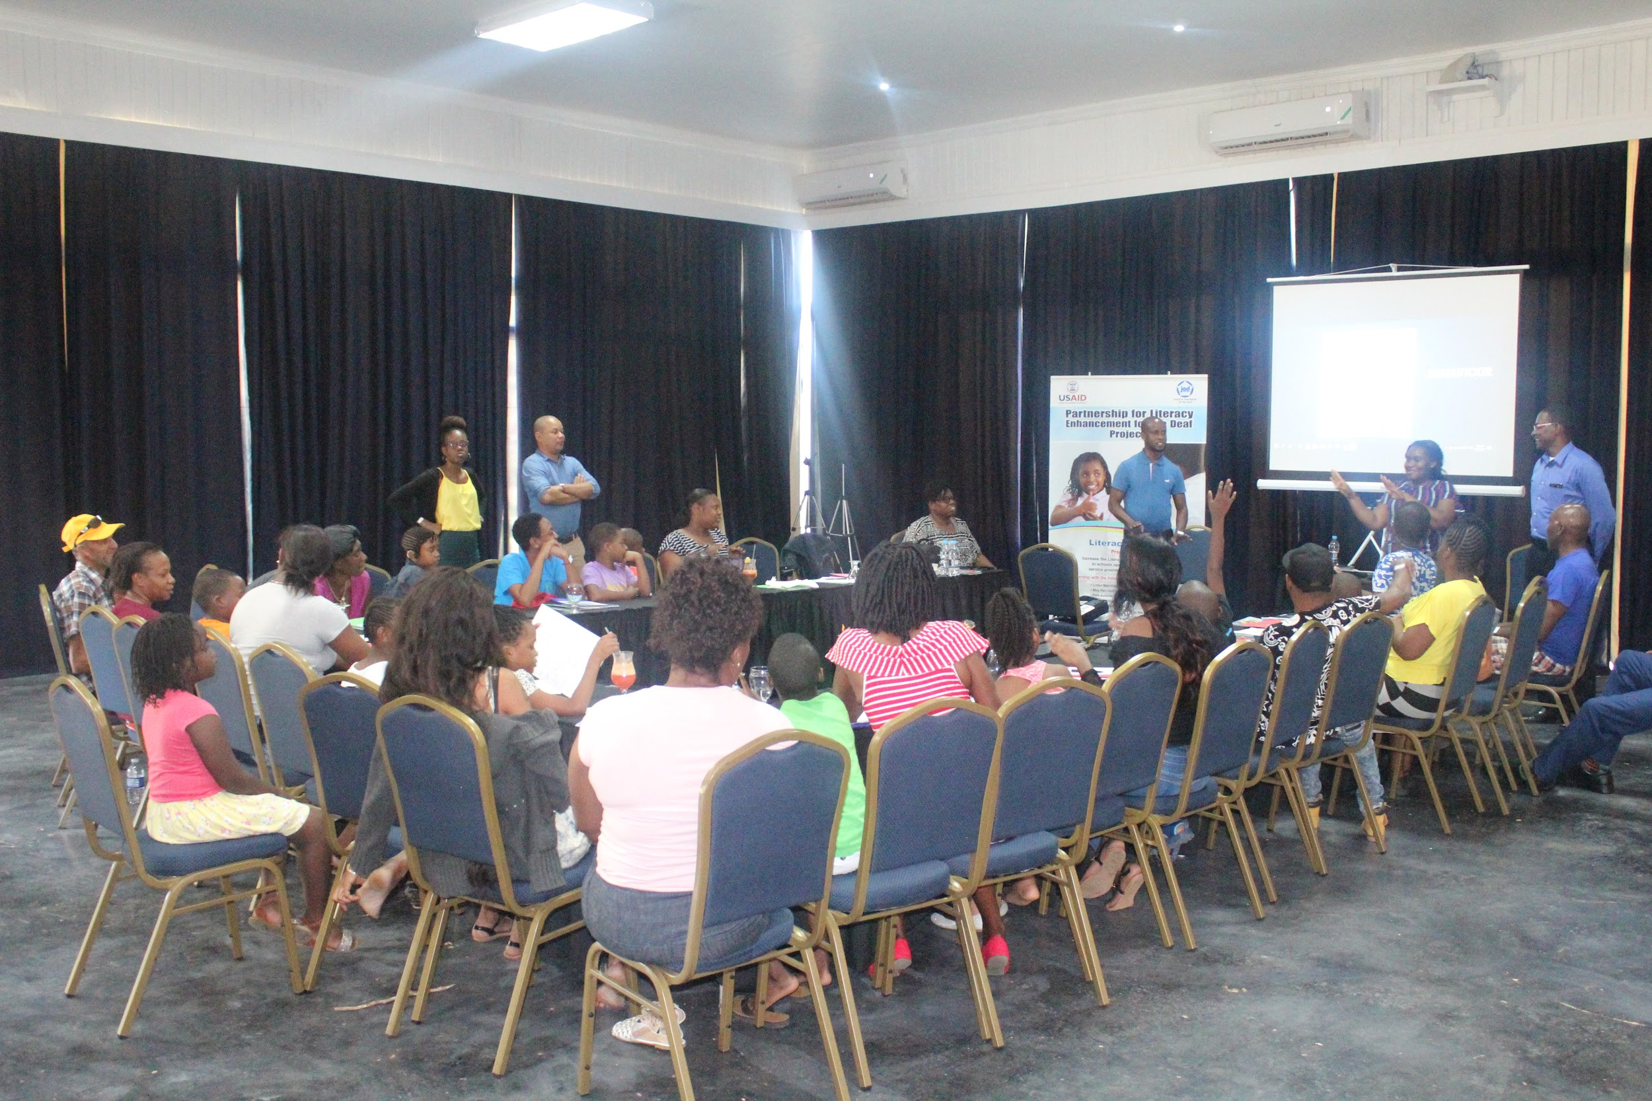
Presentations/Training on various topics:
Preventing Learned Helplessness
Supporting Literacy Development at Home
Strategies to increase my child’s Literacy
Coping with Parenting Children with Disabilities
What is Deafness and Levels of Hearing Loss
Notes:
Parent Silent Weekends
JSL & Literacy Enrichment Weekend
Parents Days

Slide 17
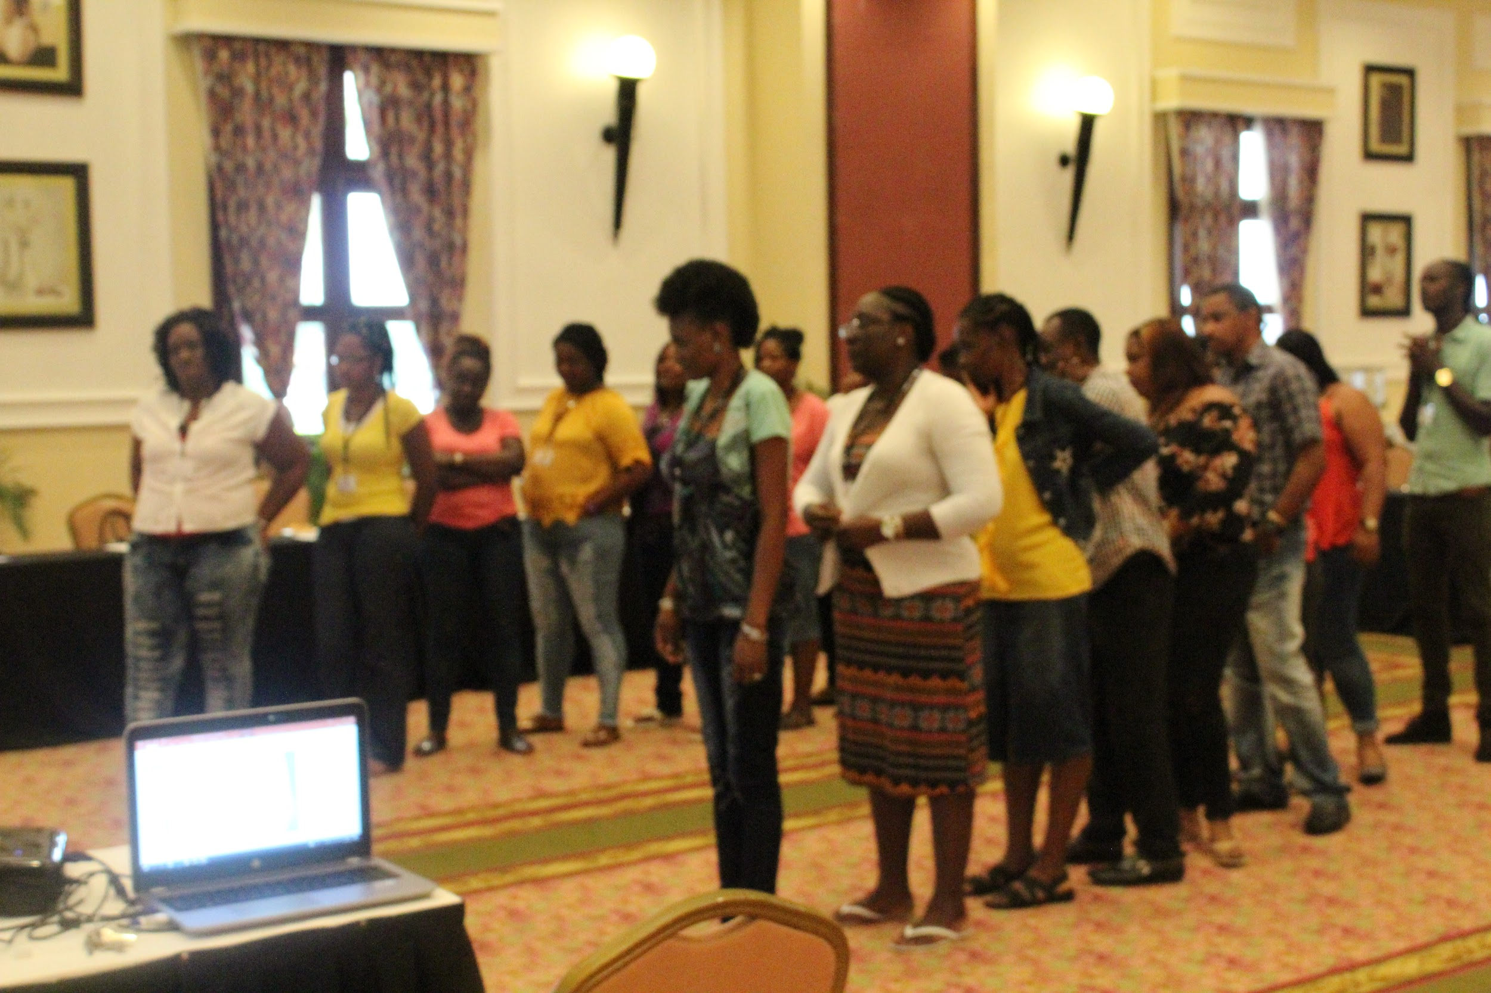
Presentations/Training on various topics such as:
Child Rights and Protection
Psychological Impact of Deafness and other disabilities on development
Schools/Services for the Deaf in Jamaica
Shared Reading Principles
Jamaican Sign Language Curriculum
Notes:
Parent Silent Weekends
JSL & Literacy Enrichment Weekend
Parents Day

Slide 18
Shared Reading Program (Home Visits)
Once a week intervention for 1.5 hours for 10 weeks by trained tutors
Children are present
One book per session. Books are left with parents to continue practicing until next session.
Parents are chosen based on their previous exposure to JSL
Notes:
Identifying parents with JSL Skills posed a challenge

Slide 19
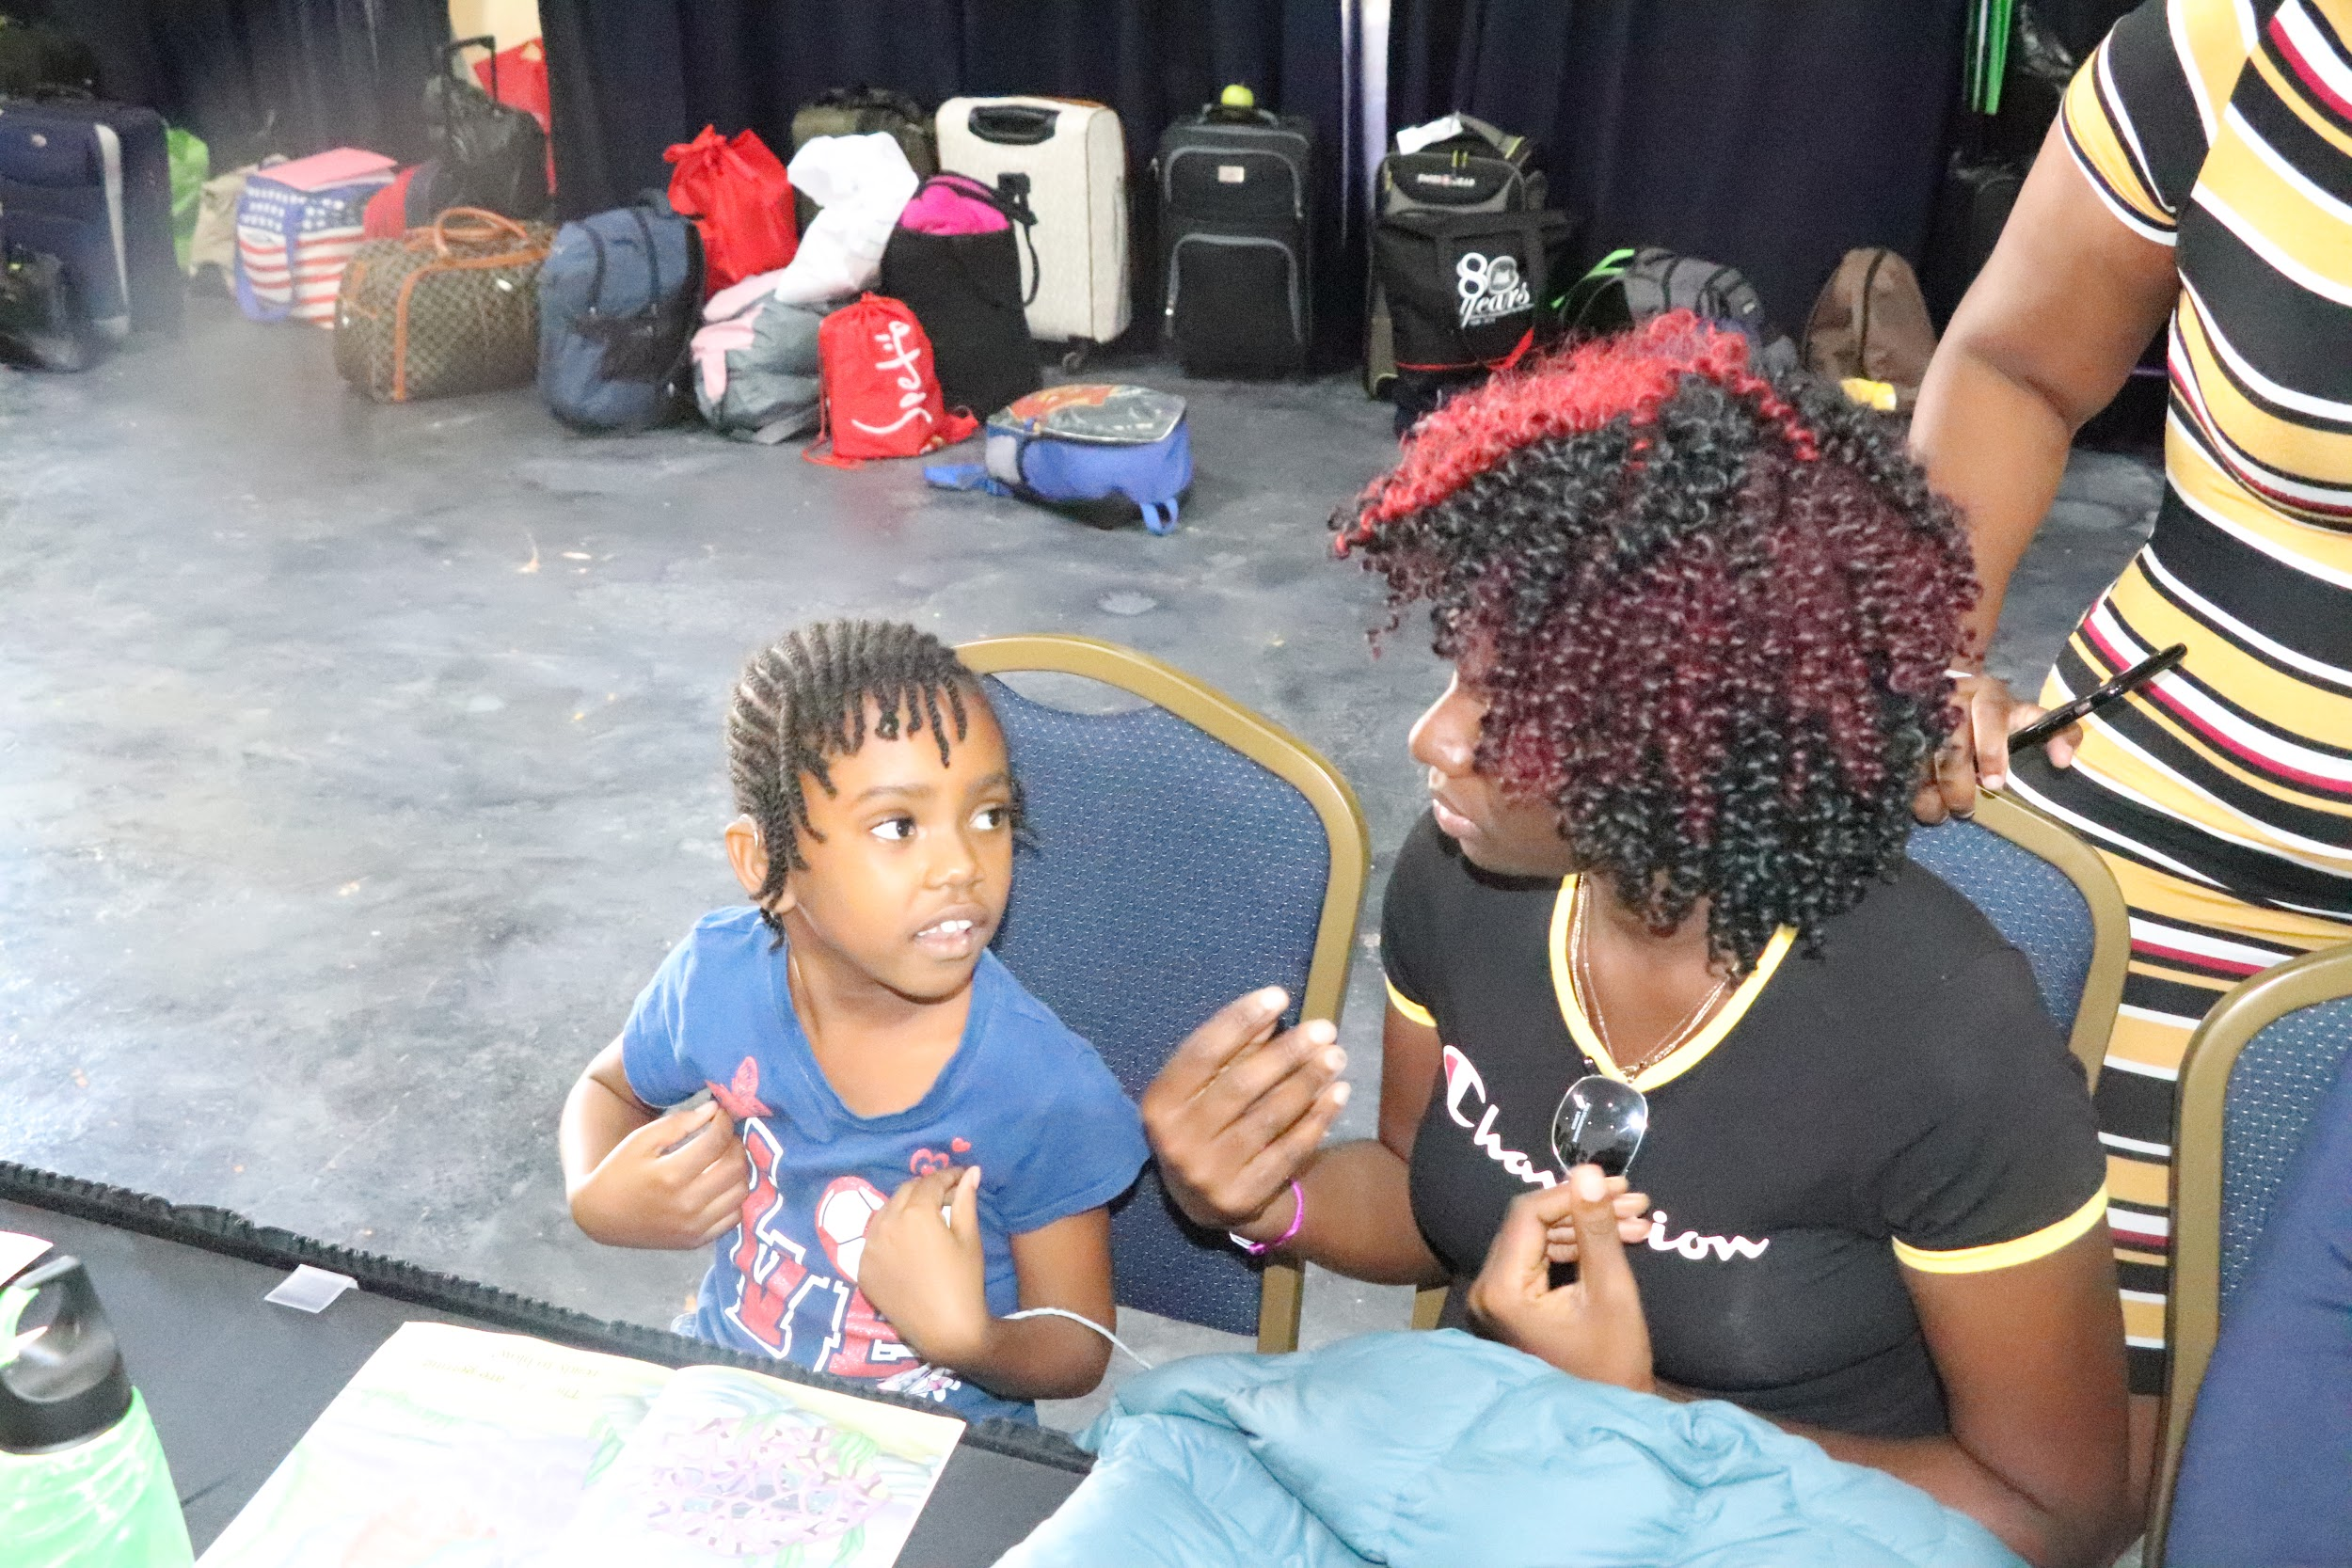
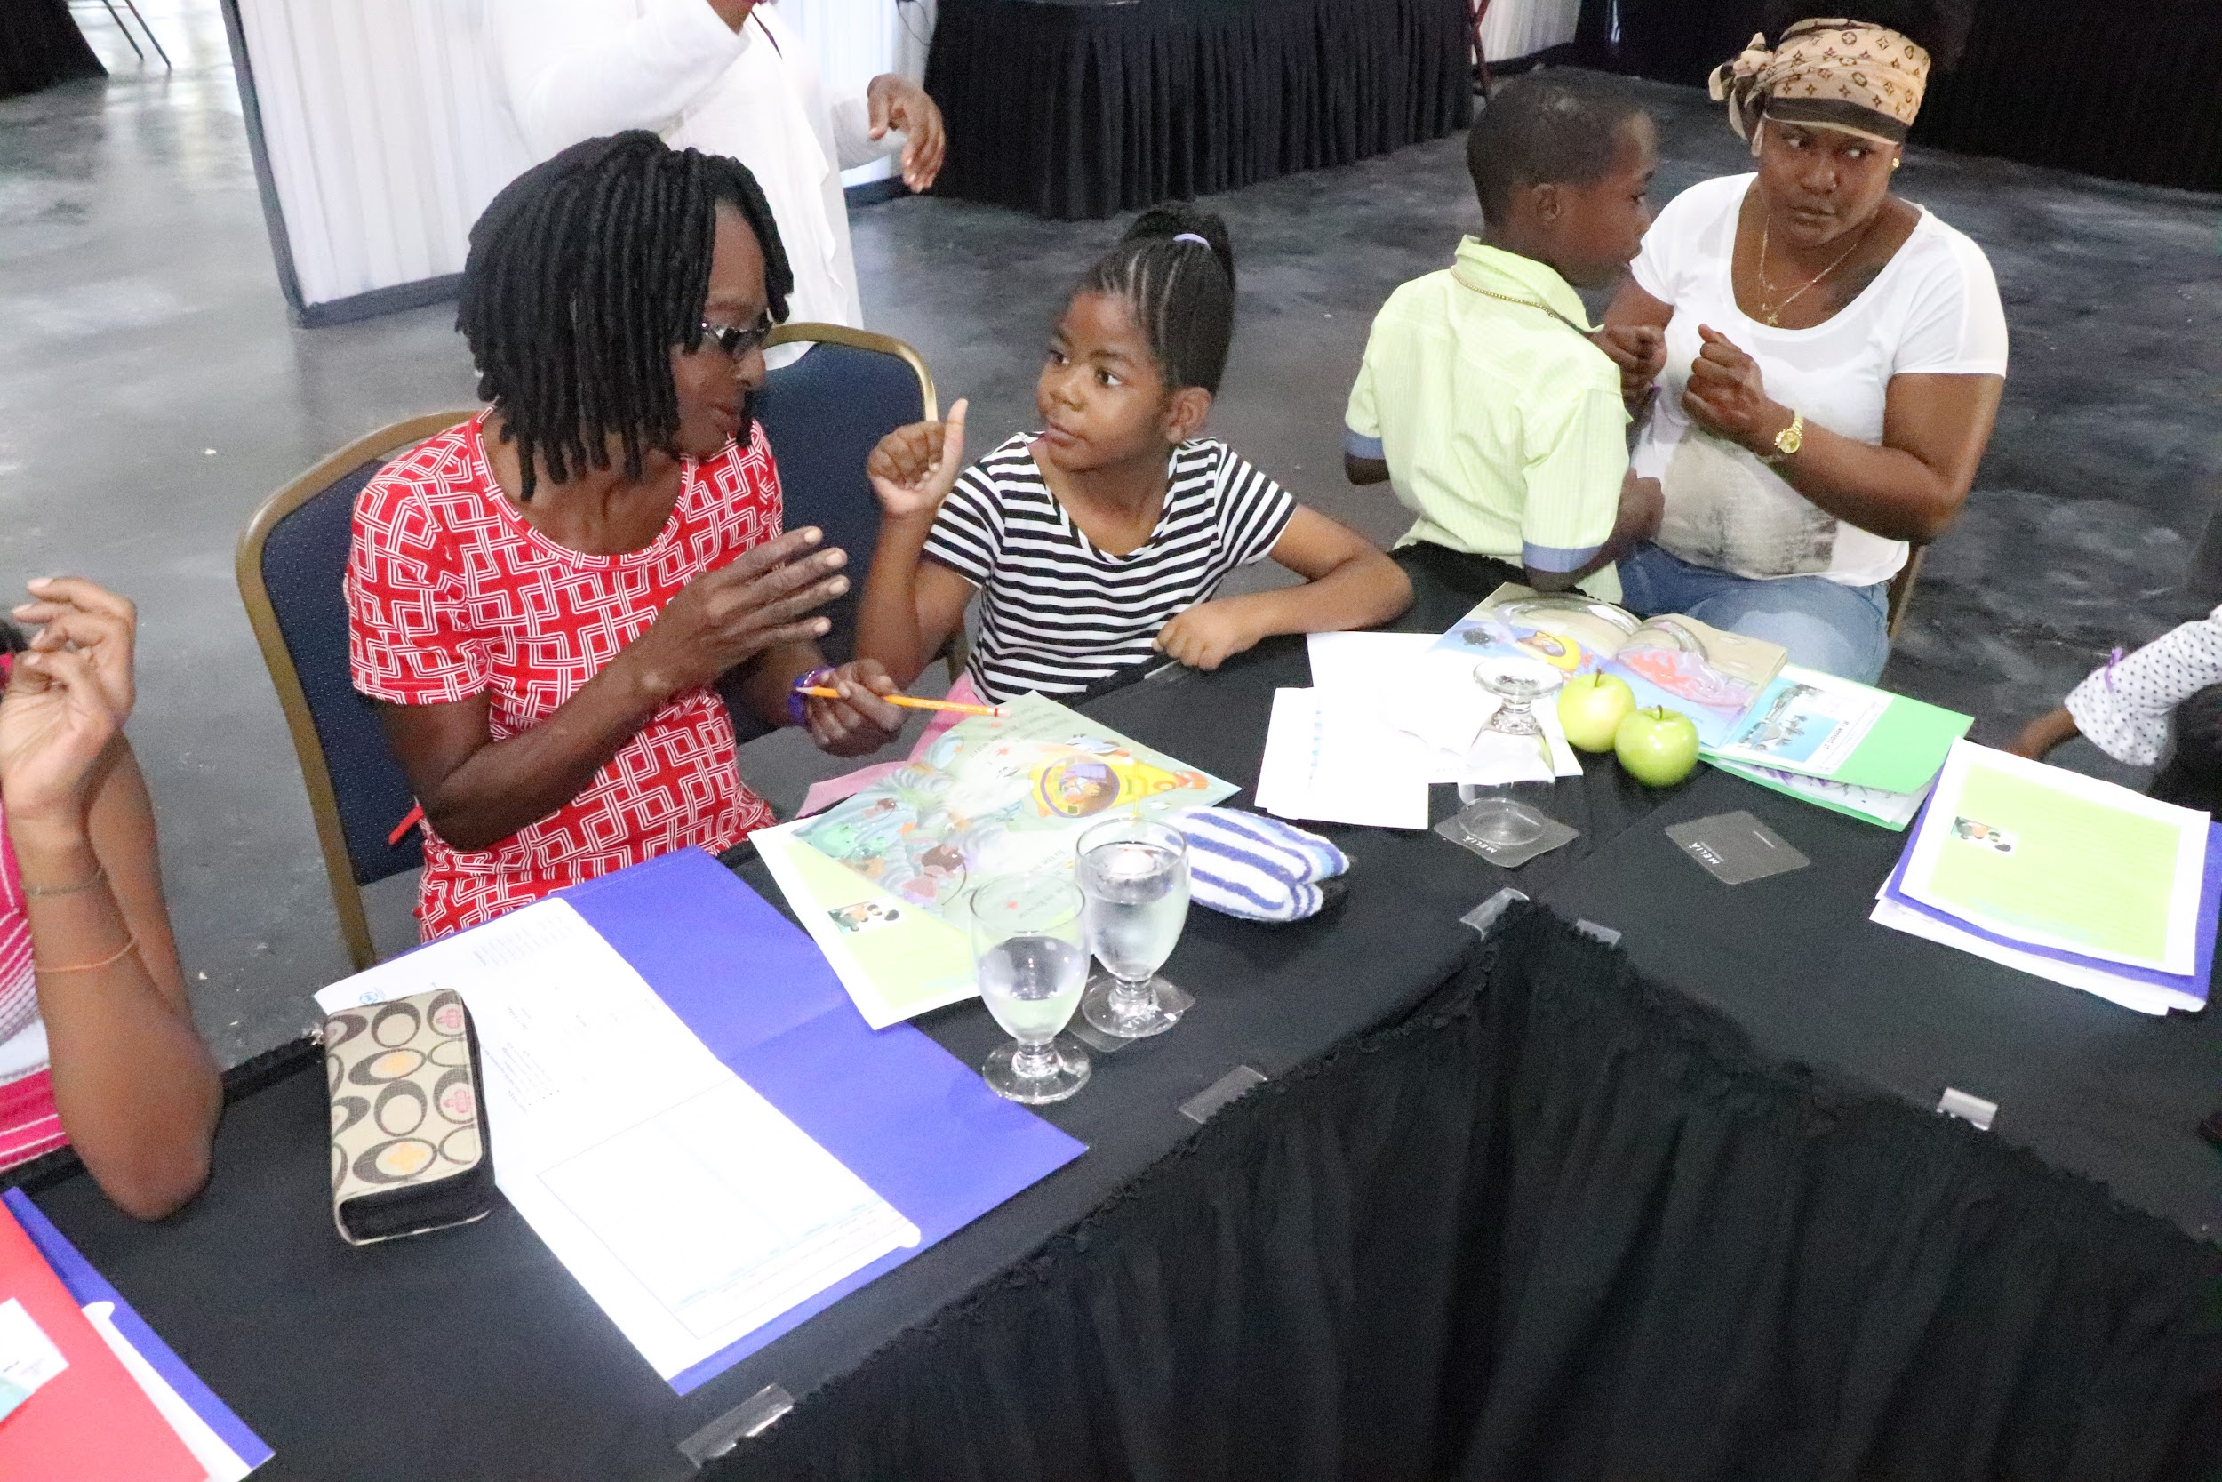
Shared Reading Component - Jamaican Sign Language & Enrichment Weekend Workshop Three day weekend intervention)
Parents
trained in Shared Reading Principles
provided the JSL vocabulary for key concepts in the book
work in small groups with tutor to practice reading with their children
receive books to keep for further practice at home
previous exposure to JSL was not considered for selection of parents
Notes:
Identifying parents with JSL Skills posed a challenge

Slide 20
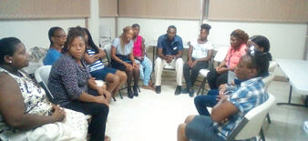
Support Groups and Group Counselling
Support groups
Led by M.Sc Counselling Psychology interns.
Groups of 10.
Hosted before JSL Classes on a weekly basis
Group Counselling
Groups of 15
Closed sessions Hosted by at least 2 Trained counsellors

Slide 21
WHAT’S APP SUPPORT GROUPS
Established subsequent to weekend workshops
Aimed at proving an ongoing forum for parents to receive support from the project officers and each other
Announcements re major events shared
Discussions regarding their children or school events
Under-utilised

Slide 22
SUMMARY OF RESULTS
INTERVENTION | Number of Participants | AVERAGE INCREASE IN JSL RECEPTIVE SKILLS | PERCENTAGE PASS
JSL Classes | 86 | - | 47%
Parent Silent Weekends | 59 | 3% | Not Measured
JSL & Literacy Enrichment Weekends | 39 | 20% | Not Measured
Follow-up Workshop | 30 | 7% | Not Measured

Slide 23
Pas Rate for JSL Classes Disaggregated by Relationship to D/HH Child
Relationship to Child | Percentage of Total Participants | Pass | Fail | Dropout
Stepmother | 2% | 50% | 50% | 0%
Sister | 7% | 83% | 0% | 17%
Aunt | 6% | 40% | 40% | 20%
Brother | 5% | 50% | 25% | 25%
Mother | 60% | 48% | 17% | 35%
Grandmother | 6% | 60% | 0% | 40%
Father | 10% | 22% | 0% | 78%
Uncle (n=1) | 1% | 0% | 0% | 100%
Cousin (n=1) | 1% | 0% | 0% | 100%
Stepfather(n=1) | 1% | 0% | 0% | 100%
Total | 100% | 47% | 15% | 38%
Notes:
Discuss the breakdown

Slide 24
20%
7%
Increase in the JSL Receptive Skills among participating parents in the first round of JSL & Literacy Enrichment workshops
Increase in the JSL Receptive Skills among participating parents in the follow-up workshop

Slide 25
How often did you use JSL when communicating with your Child?
25% of sample indicated that they never used JSL to communicate with their children before the interventions, which was reduced to 8% after the intervention
After the intervention, 38% (an increase of 13 percentage points) indicated that they most times or always use JSL to communicate with their D/HH children

Slide 26
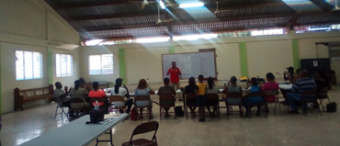
Parents’ Performance in JSL Classes
Pass Rates:
Failure Rate: 15%
Dropout Rate: 38%
Pass Rate: 47%
Notes:
Most parents are single parents (matriarchal)

Slide 27
Factors related to Parents’ Successful Performance in JSL Classes
Gender and Relationship to Child:
Higher number of females
Modality does not appear to work for fathers (cultural and work commitment factors)
Mothers encumbered with child care and affairs of the home
Geographical Location of Classes
Regional approach in rural areas had higher dropout and failure rates likely due to distance
Days and Time of classes
Weekends yielded higher dropout rates
Start time coincided with work schedule
Notes:
Most parents are single parents (matriarchal)

Slide 28
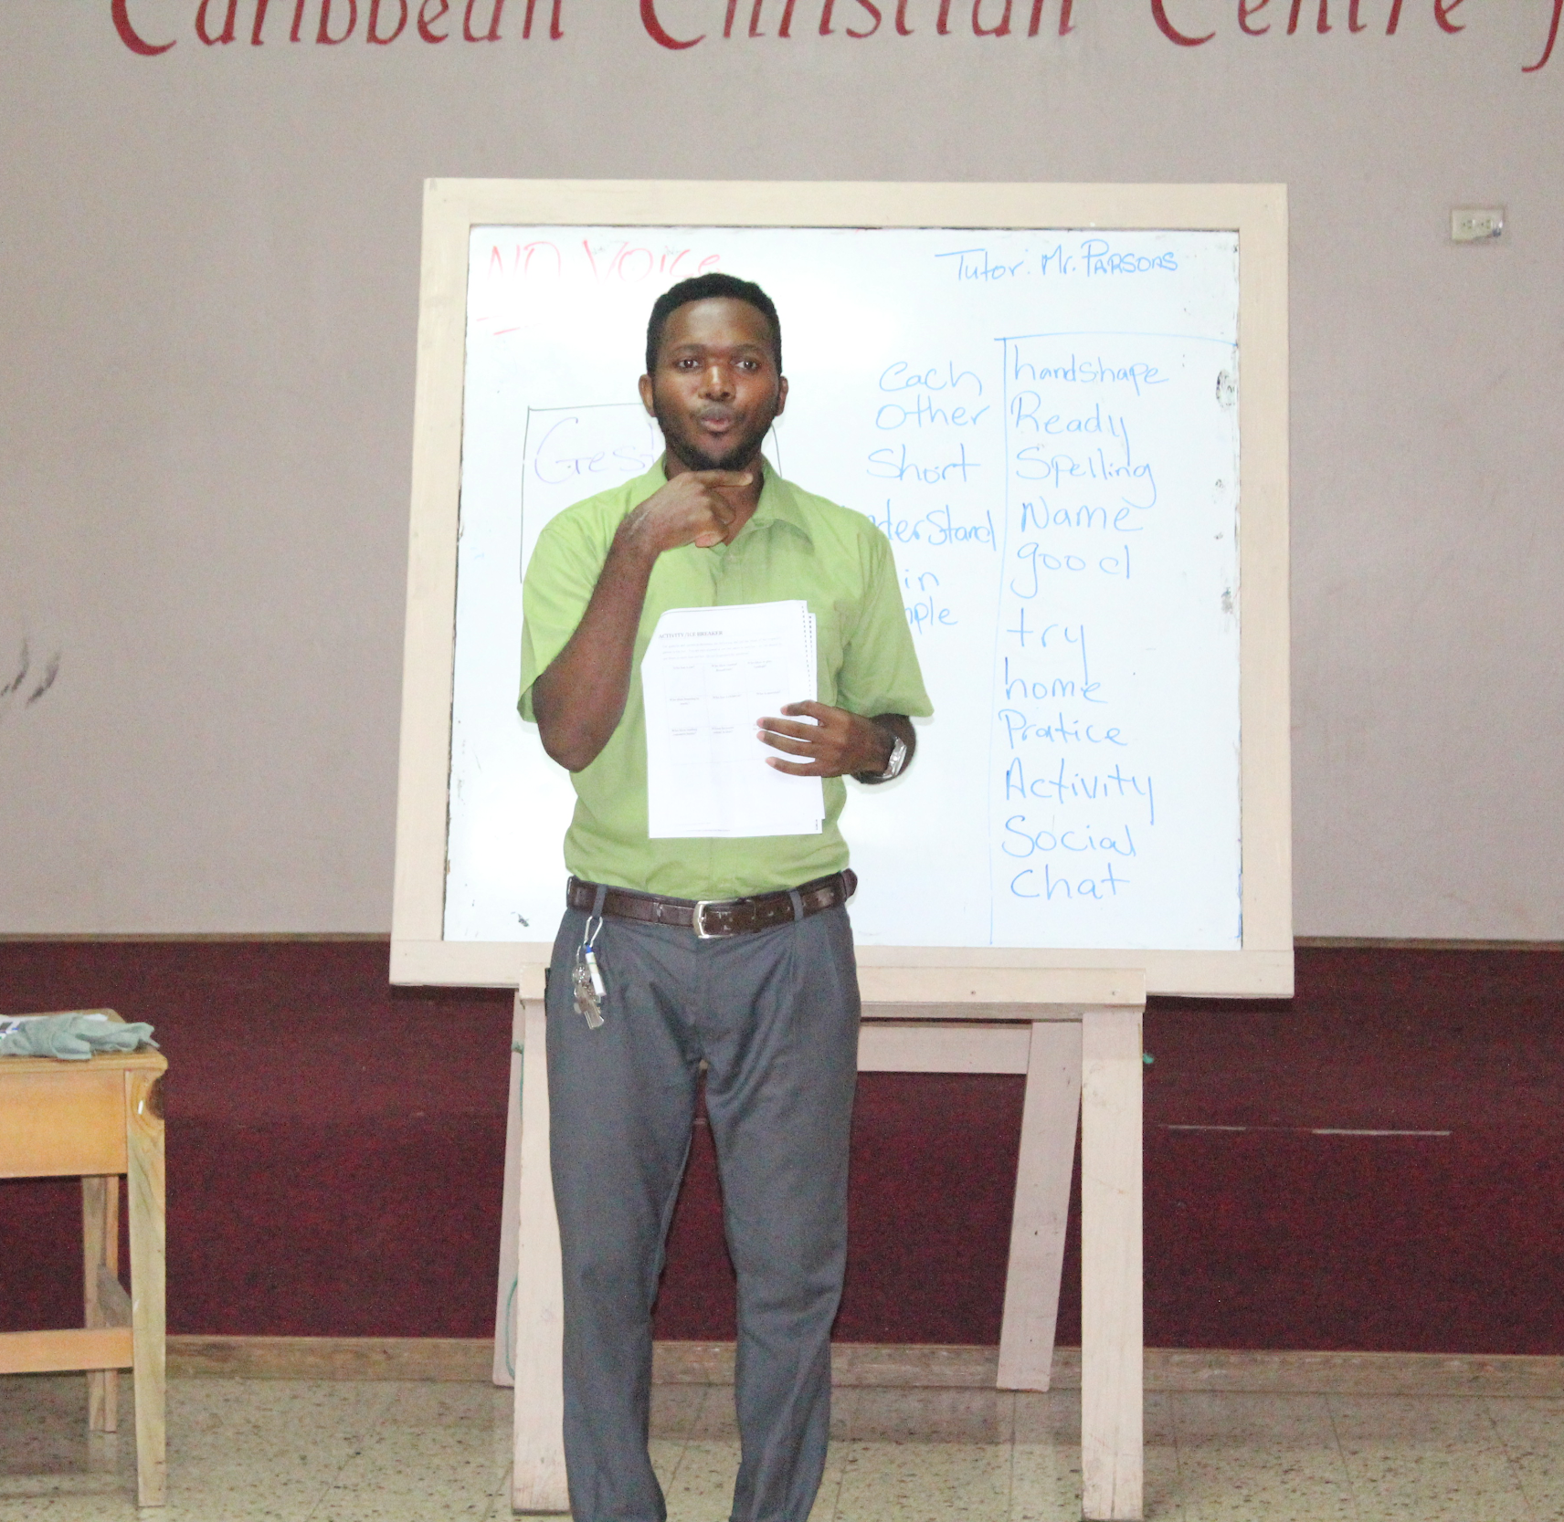
Factors related to Parents’ Successful Performance in JSL Classes
Modality:
Language Immersion Approach with Voice Off - No interpreter used
Parents were grasping the vocabulary but struggled to identify same within context and in conversation. For example, when tutors signed “Show me your homework,” The majority of parents could identify the word “homework” but struggled to complete the sentence.
Parents:
Literacy Level
Signing JSL was challenging for most parents
Attitude to JSL
Notes:
Signing JSL was challenging for most parents, as they struggled with understanding the language and remembering the signs

Slide 29
Factors related to Parents’ Successful Performance in JSL Classes
PARENTS SAY they do not attend because:
Medical emergencies
Notice of classes too short
No interest in learning JSL
Misinformation re location and time
Children have multiple disabilities and hard to manage
Work commitments
They do not live with the children
Notes:
Signing JSL was challenging for most parents, as they struggled with understanding the language and remembering the signs

Slide 30
LOCAL CHALLENGE #2:
Parents have difficulty with knowledge about parenting a Deaf /Hard of Hearing child

Slide 31
WHAT’S APP SUPPORT GROUPS
Established subsequent to weekend workshops
Aimed at proving an ongoing forum for parents to receive support from the project officers and each other
Announcements re major events shared
Discussions regarding their children or school events
Under-utilised

Slide 32
Findings and Observations
Cultural Approaches to Counselling, for e,g “ That kind of thing not for me…”
JSL-based skills for Shared Reading are reported as least favoured, for e.g. Connect concepts in the story to the real world. Relate the characters to real events
General skills for Shared Reading are more frequently used, e.g. Provide a positive and reinforcing environment. Encourage the child to share ideas about the story and support the child's ideas

Slide 33
Findings and Observations
Home Visits proved challenging in the context of limited resources and timeframe
Parents dwell in volatile areas and as such the safety of the Tutors was in question
Readiness of the family to engage tutors at assigned times
Suitability of the home environment to accommodate the tutor
Approach had to be switched
Source: Interview with coordinators and tutors

Slide 34
Parents’ Self Reports: Practices
Survey Item | BEFORE | AFTER | Percentage increase
Did your child enjoy reading with you? | 59% | 81% | 22%
How confident did you feel reading to your child? | 64% | 88% | 24%
How comfortable were you with using the Shared Principles that were taught? | 59% | 96% | 37%
How often did you read to your child? | 18% (Most times/Always) | 26% (Most times/Always) | 8% (Most times/Always)
How often did you read with your child? | 14% | 29% | 15%
Notes:
Frequency still remains an issue

Slide 35
Parents’ Self Reports: Practices
Survey Item (Self Reports) | BEFORE | AFTER | % Change
Did you allow the child to be more independent (age appropriate)? | 75% | 82% | 7%
How often did you use JSL when communicating with your Child? | 25% | 38% | 13%
Did you feel more confident using JSL to communicate with your child? | 53% | 73% | 20%
How often did you help your child with homework? | 63% | 67% | 4%

Slide 36
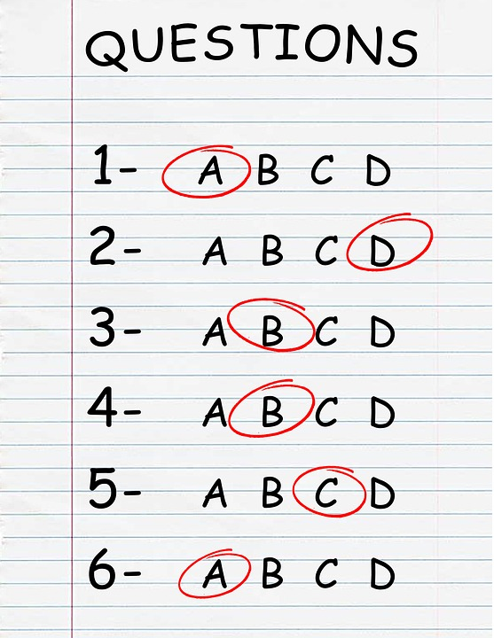
Pre/Post Test Measures - Weekend Workshops
Pre Tests | 85%
Post Tests | 94%
Increase | 9%
Questions on content from parent training sessions

Slide 37
Challenges emerging from the Discourse with Parents …...
Financial burden of raising a Deaf child alone
Boarding hinders development of relationship with child
Absence of father figure, parental separation and lack of support in raising the child
Inadequate parental involvement in academic development
Literacy Level of Parents
PARENTAL FACTORS
Notes:
Emerging from Group support discussions,

Slide 38
Challenges emerging from the Discourse with Parents …...
Acceptance of the Deafness of the Child
Low confidence and interest in themselves and their Deaf/Child
Parent’s own emotional baggage and other personal stressors
Insufficient understanding of Deafness and children’s developmental stages
Effective Behavioural Management Skills
PARENTAL FACTORS
Notes:
Emerging from Group support discussions,

Slide 39
Challenges as expressed by the Parents
Child Factors
Child’s attitude to school and English
Behavioral Challenges refusing to sign to communicate with parents and others
Speech defect of child
Fears:
Fear of leaving child alone because of deafness
Fear of child being sexually abused

Slide 40
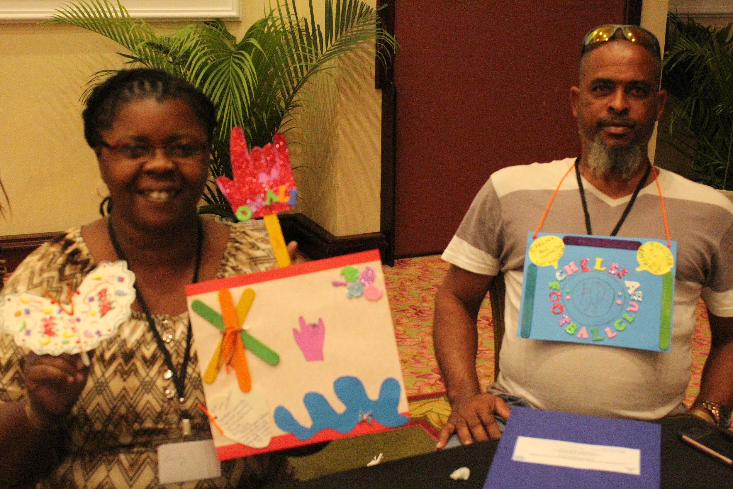
PARENTS’ FEEDBACK
“I know that I should let her take charge...before I would just tell her that we were going to read and I read to her and that’s it. But now I know I must follow her lead and even if she is reading something wrong I’ll let her go ahead then show her the right way…”

Slide 41
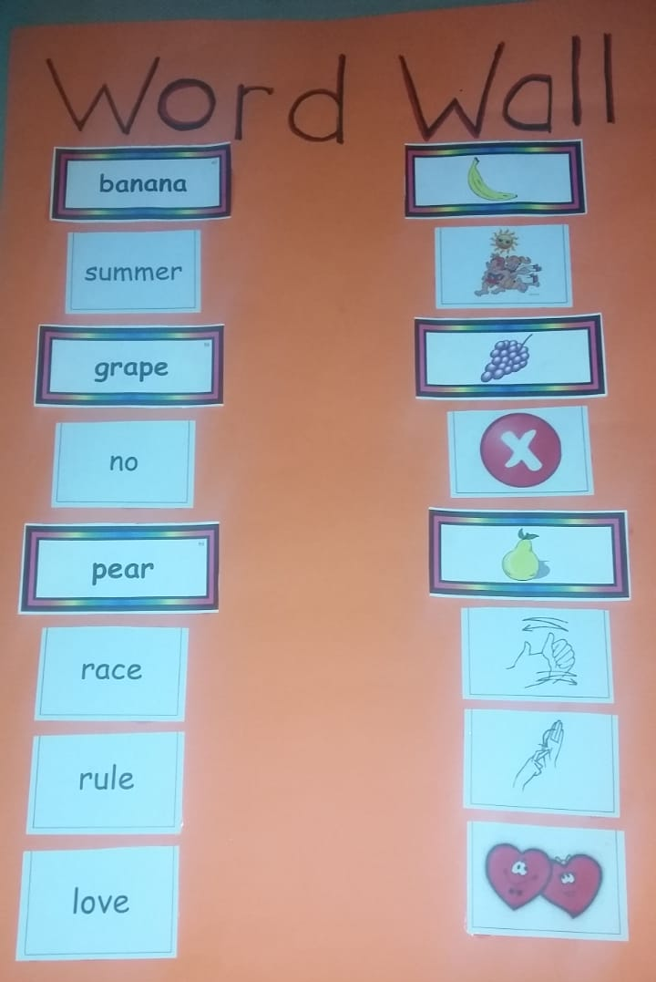
PARENTS’ FEEDBACK
“Well I am I am new to sign, first experience because my little boy just got into the school just a couple a months ago, found out that he had the hearing problem so he just started the school maybe a month or so ago? So he’s new and I am new but I learn a few signs so when he comes like now I would be able to help him, and I want to say thanks in a million for this opportunity…”
“

Slide 42
Parents’ Feedback:
“…. I feel like I can connect with her more and about her culture”
“I understand now, so I don’t feel so bad.”
“…. For me, I didn’t know JSL. But now that I know a little. I promise to do more and to do more signing.”
Notes:
Please bear in mind, the parents have D/HH children who are AT LEAST 6 years old. Some as old as 20 years old

Slide 43
Parents’ Feedback:
“I wasn’t aware of the big successes of Deaf Children. This [workshop] has encouraged me to set goals for her and to interact with her more”
“When you understand, you can cope more”
“Understanding sign language was hard at first, but over the weekend I learnt more about the language and how to use it”

Slide 44
PARENTS ASK….
Can……..
Other family members be included?
The workshops be extended time to allow for a stronger reinforcement of the JSL Signs?
Additional sessions be held with parents and children?
Take home materials be provided for revision and practice?
More community-based JSL Classes be held?
JAD provide ongoing support to the families?
We receive more JSL videos via WhatsApp

Slide 45
Addressing the PROCESS challenges for Interventions for increasing Parents’ JSL Skills
Challenge | How was it addressed
Literacy Level of Parents | Tutors and coordinators read or sign aloud for all parent participants. One on one support by project staff
Low attendance due to inclement weather, concerns for child care, work commitments and distance. (“I have to work, plus I really didn't have any interest. But since this workshop, I definitely have the interest now”, Father of a 7 year old female) | Travel stipend and meals provided Children are allowed in sessions Classes held in evenings after work or on weekends Parents are reminded weekly using whatsapp, SMS or phone calls

Slide 46
Addressing the PROCESS challenges - Parent Support Activities
Challenge | How was it addressed
Time availability of parents to attend workshops | Letters sent to work supervisors Activities held on weekend
Misalignment of Rationale for Attendance | More deliberate selection of participants
Person who attend sessions does not live with child | More deliberate selection of participants
Safety of Tutors during home visits | Tutors travel with a colleague Meet at a neutral spot such as a church or a school
Parental JSL Skills, interests and attitudes | INTERVIEW GERALDINE OR TUTOR
Schedule of Project Activities and availability of Trained Tutors | Hosting of the JSL & Literacy Enrichment Weekends

Slide 47
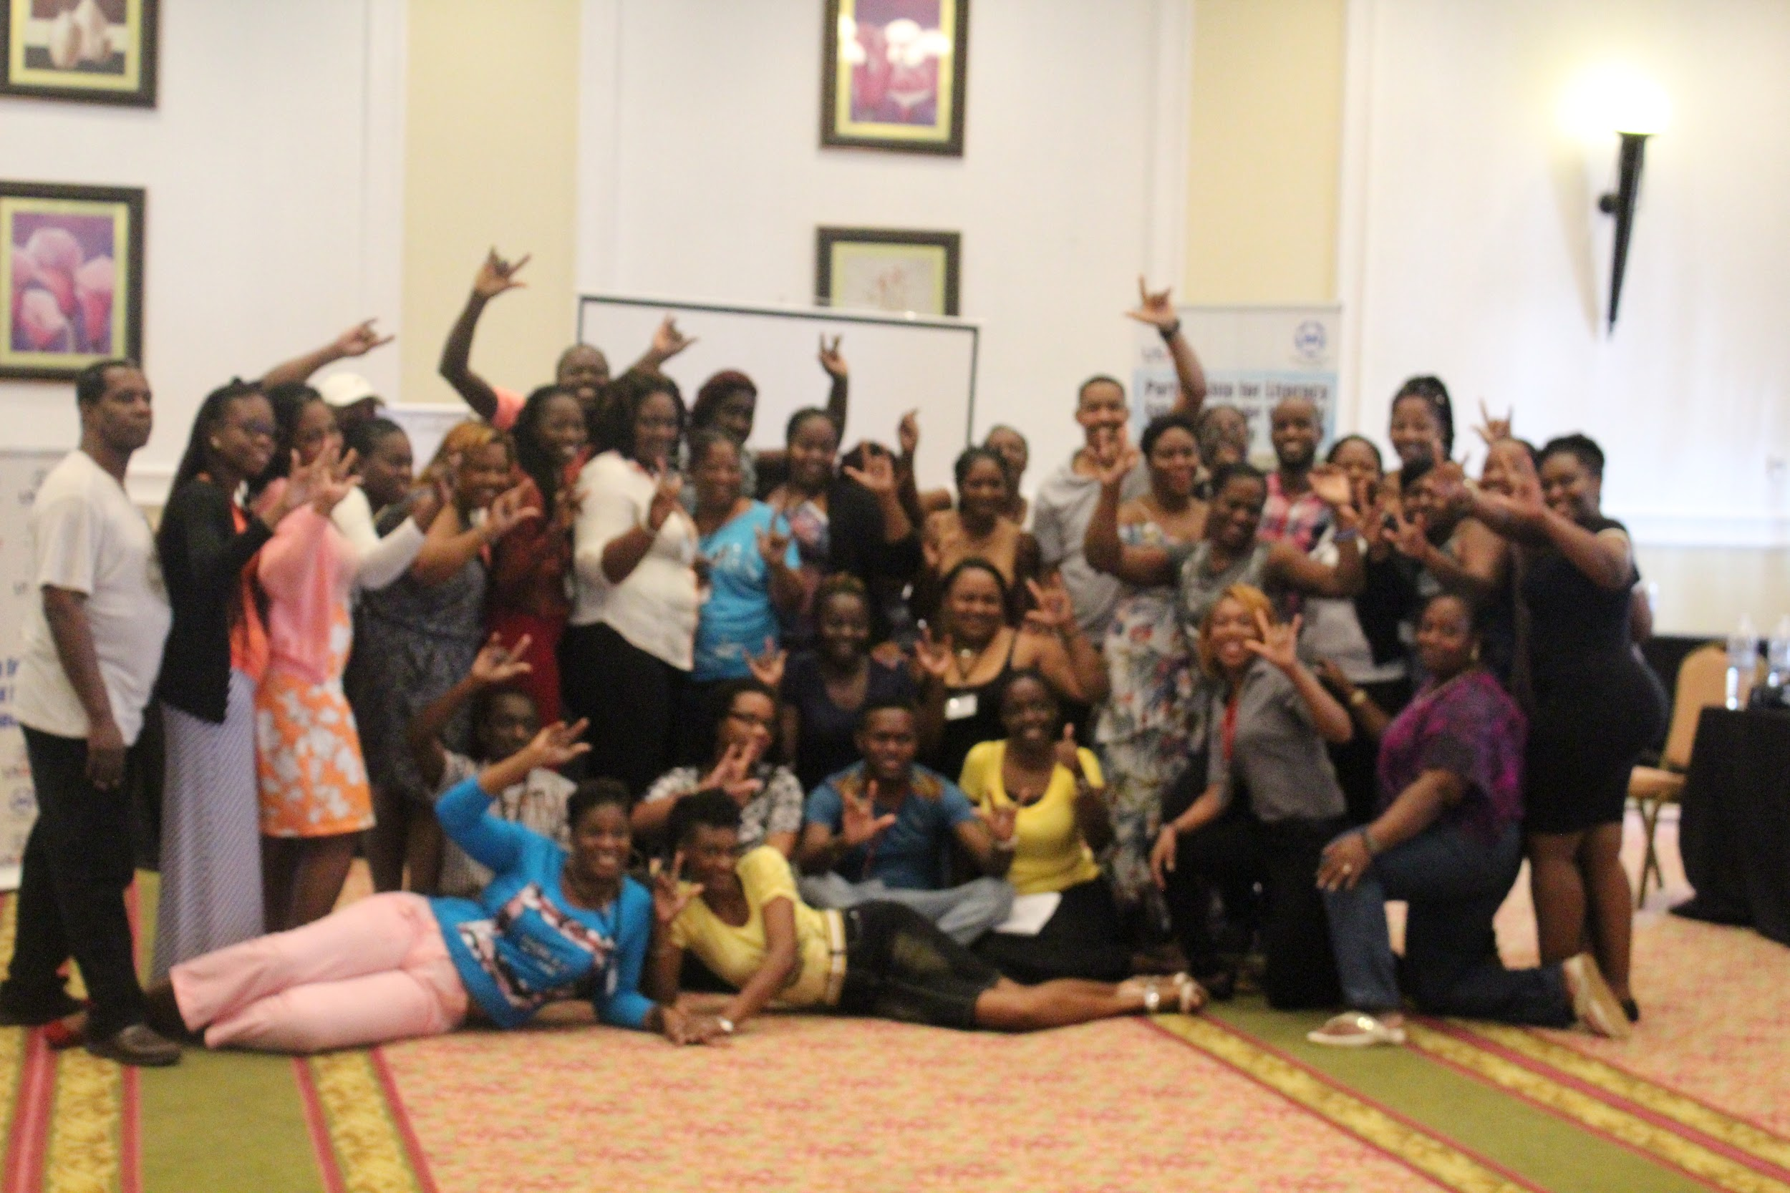
LESSONS LEARNT: Factors to treat with:
Geographical location and distance
Residential vs Commuting
Motive for attending weekend workshops held at hotels
Compensation for travel
Time,Day and Frequency of activities
Instructional methodology
Appealing to the cultural factors
The MALE factor

Slide 48
LESSONS LEARNT: What works and What doesn't:
Approach | Works? | Does not work
JSL Classes (Regional Approach) | 😎 | 😰
Parent Silent Weekends
JSL Receptive Skills |  | 😰
Parenting Support | 😎
JSL & Literacy Enrichment Weekends
JSL Receptive Skills |  | 😰
Parenting Support
Shared Reading | 😎
Shared Reading - Home Visits |  | 😰
Parent Support Groups | 😎

Slide 49
RECOMMENDATIONS AND WAY FORWARD
Replicate design with considerations for extended intervention periods and ongoing support (out of workshops)
Complete intake assessment before any intervention to provide a more robust database of parents
More rigid selection criteria for participation
Redesign approaches to cater to the males; specifically the fathers
Explore a parent-led/trainer of trainers approach

Slide 50
WHAT DADDY HAS TO “SIGN”.....

Slide 51
References
nHlatywayo1, L. & Muranda, A. Z. (2014). A study into the involvement of parents in literacy development programmes for Deaf learners. International Journal of Novel Research in Education and Learning, 1(2), 38-45. Retrieved from www.noveltyjournals.com
National Institute on Deafness and other Communication Disorders. (2016). Retrieved from https://www.nidcd.nih.gov/health/statistics/quick-statistics-hearing#pdf
Poon, B. T. & Zaidman-Zait, A. (2014). Social support for parents of Deaf children: Moving toward contextualized understanding. The Journal of Deaf Studies and Deaf Education, 42(19), 176–188. Retrieved from https://doi.org/10.1093/deafed/ent041
The Planning Institute of Jamaica. (2015). School-to-work transition of the Deaf in Jamaica. Retrieved from https://www.pioj.gov.jm/Portals/0/Social_Sector/FINAL-DeafStudy-Oct-7-2015(merged%20with%20Deafness%20Terminology).pdf

Slide 52
Thank you for your participation!
Any Questions?
Meet with us at the break so we can network!
See you soon in Jamaica?

