Slide 1
An Inclusive Jamaica for the Deaf Community: A Situational Analysis (Kingston and St. Andrew)
Donna Harris, Kimberley Sherlock Marriott Blake, Tisha Ewen-Smith & Shauna-Kaye McArthur
DISES Regional Conference, June 2019

Slide 2
RATIONALE AND BACKGROUND
Someone being included in society means they are necessary as the environment facilitates their full participation especially when they are vulnerable.
Social inclusion of vulnerable groups is demonstrated when opportunities abound, there is access to resources, their voice is heard and their rights are upheld (United Nations, 2016).
Of all the vulnerable groups in society, the Deaf Community is the most excluded because they have a difficulty having basic communication with the general hearing population.
Ultimately, they end up being excluded from social, educational and employment opportunities (The Planning Institute of Jamaica, 2015).

Slide 3
Legal & Policy Support for PwDs
UN Convention on the Rights of Persons with Disabilities (2007)
Child Care & Protection Act (2004)
Other international agreements exist to support PwDs
National Disability Act (2014)
Vision 2030
Notes:
Now the CRPD is the leading policy that is above all these other international agreements
World Programme of Action Concerning Disabled People (1981)
Principles for the Protection of Persons with Mental Illness and the Improvement of Mental Health (1991)
Standard Rules on the Equalisation of Opportunities for Persons with Disabilities (1993)
Declaration on the Rights of Disabled Persons (1995)

Slide 4
RESEARCH QUESTIONS
What have been Jamaica’s efforts to be more inclusive in the education sector within the past 20 years?
What have been Jamaica’s efforts to be more inclusive in the social welfare sector within the past 20 years?
What are the factors affecting the inclusion of Deaf in the education and social welfare sectors in Jamaica?

Slide 5
DATA COLLECTION METHODS
SURVEY
(Agencies)
FOCUS GROUP DISCUSSIONS
(Deaf Community)
DESK RESEARCH
INTERVIEWS with Deaf Community

Slide 6
SAMPLE
Focus Groups:
23 Deaf Adults - 48% males; 52% females
52% employed; 4% self employed
31% unemployed or retired
13% - students
Surveys:
42 respondents from various organisations and agencies (Education (26%); Business (22%), Government (22%) Community Development and Donor Agencies (19%) among others (11%)

Slide 7
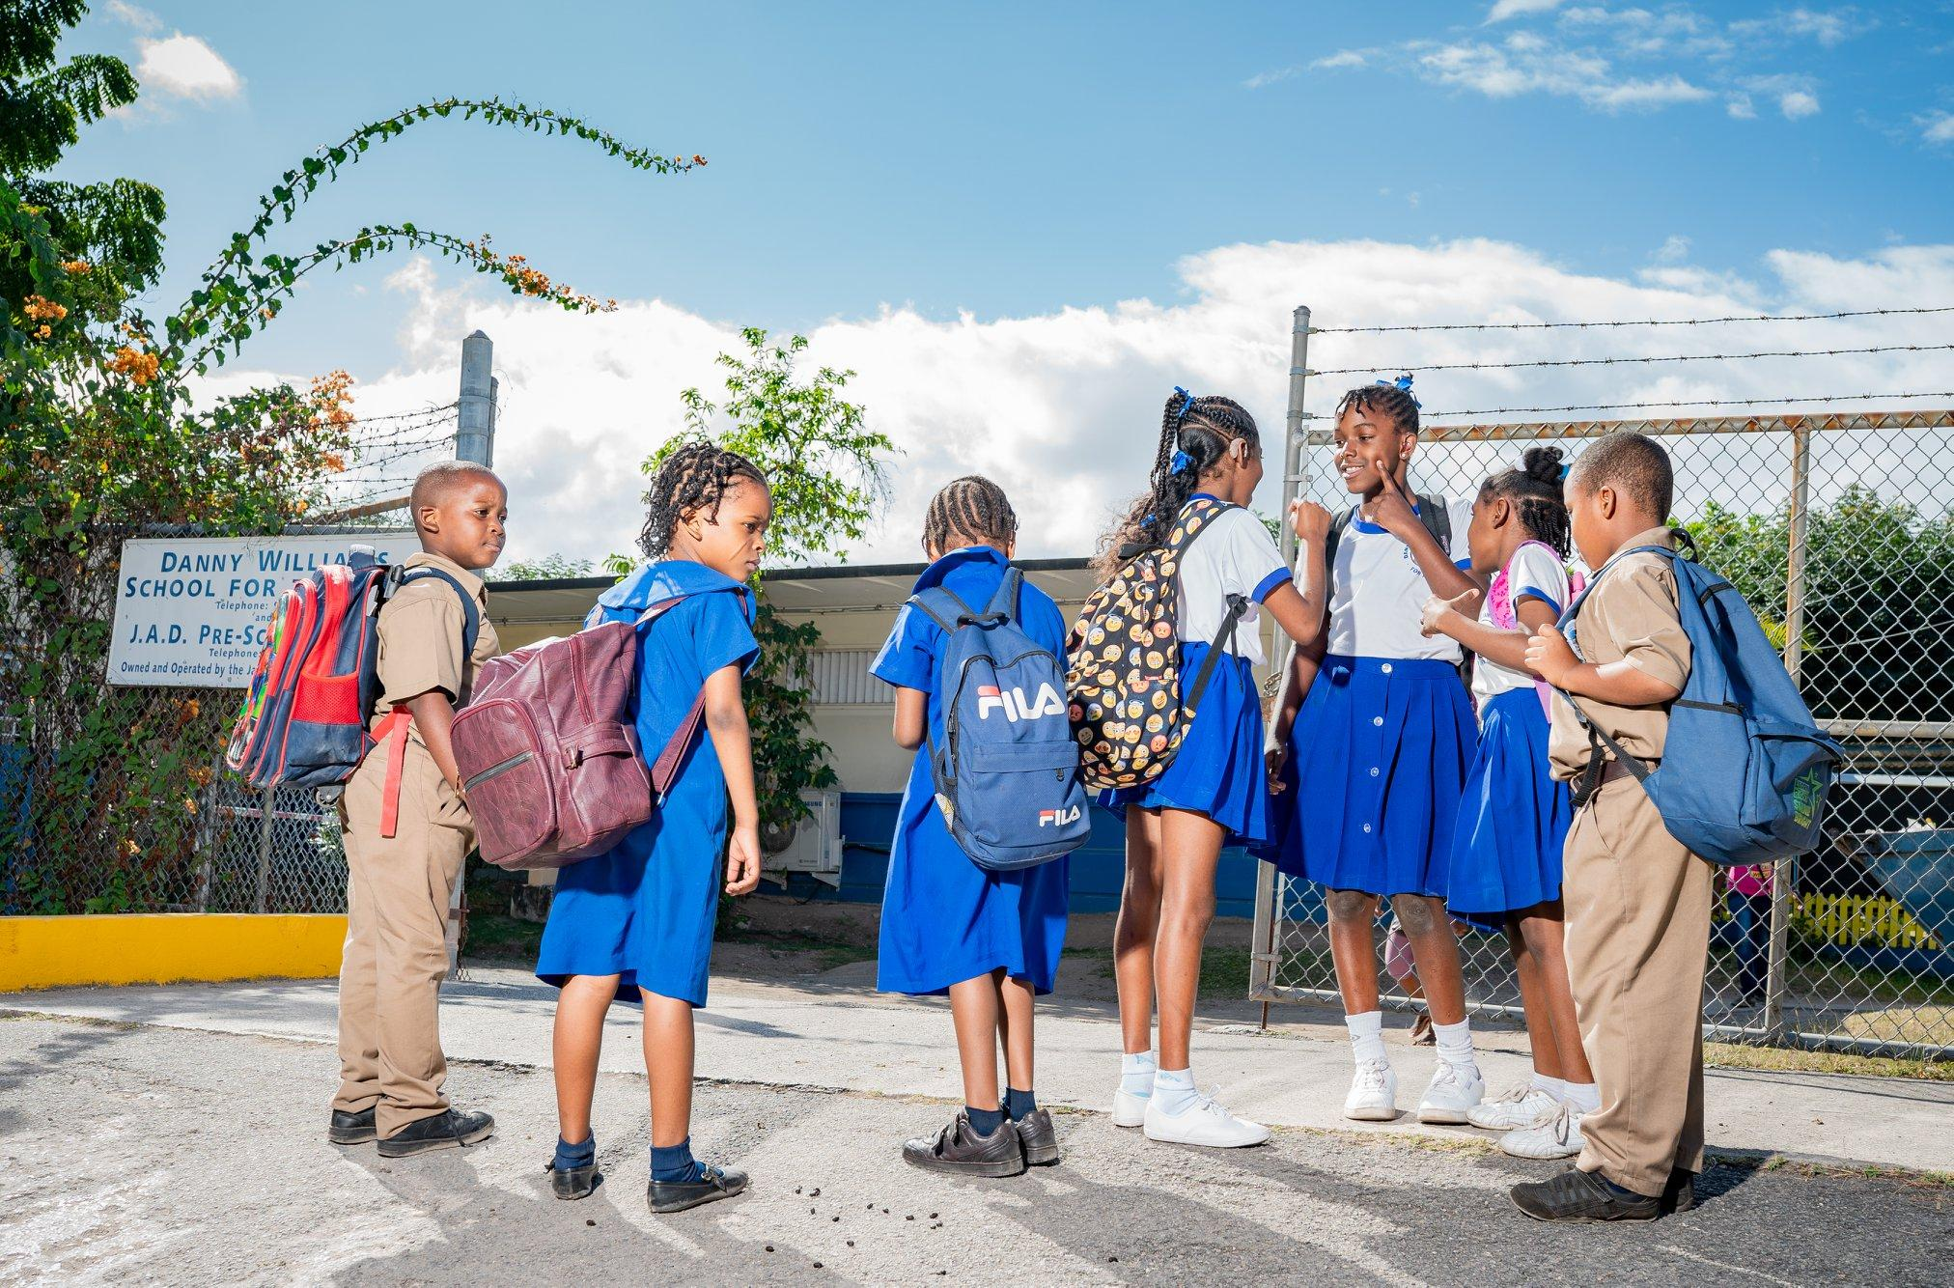
RESEARCH QUESTION 1:
What have been Jamaica’s efforts to be more inclusive in the education sector within the past 20 years?

Slide 8
JAMAICA ASSOCIATION OR THE DEAF
Oldest service institution for the D/deaf in the Caribbean
Non-governmental organisation (with charitable status) that was started in 1938
Approximately one third of staff is D/deaf
Various services for Deaf persons and their families
Hearing screening
General guidance to national support services and for independent living
Deaf Education, School placement & Student sponsorship
School to work transition support
Family support and guidance
Interpreting services
Advocacy for awareness and access

Slide 9
2. Advancements in Deaf Education
Special Projects supporting Deaf Education
Jamaican Sign Language Grammar Curriculum
Deaf Education Services by Jamaica Association for the Deaf, Caribbean Christian Centre for the Deaf, Abilities Foundation and Jamaica Christian School for the Deaf
Special accommodations for national examinations
Endorsement of the MoE for a bilingual approach to Deaf Education
Deaf Culture Facilitators

Slide 10
2. Advancements in Deaf Education (cont’d)
“…..the projects facilitated by the JAD through Education and Deaf Community development”
“……., the MOE’s recognition and inclusion of JSL as a first language for the Deaf in Schools for the Deaf”
“….the development of JSL resources to support the bilingual approach to Deaf Education”
“The success stories book series “I’m Deaf Too!” written and published by the JAD helped to establish a sense of pride and confidence in me and other Deaf persons”
“DCFs offer tremendous support in the classroom as language facilitators”

Slide 11
3. Improved Access to Tertiary Institutions
Increase in the number of students matriculating to Tertiary education
“Future for our Deaf children seems a little brighter. There is a feeling of a sense of hope.”
Improvements in accommodation by Tertiary Institutions
“The University of Technology is to be applauded for being the first university to cover the interpreting costs for the Deaf to pursue undergraduate studies there.”
Notes:
Hiring of interpreters

Slide 12
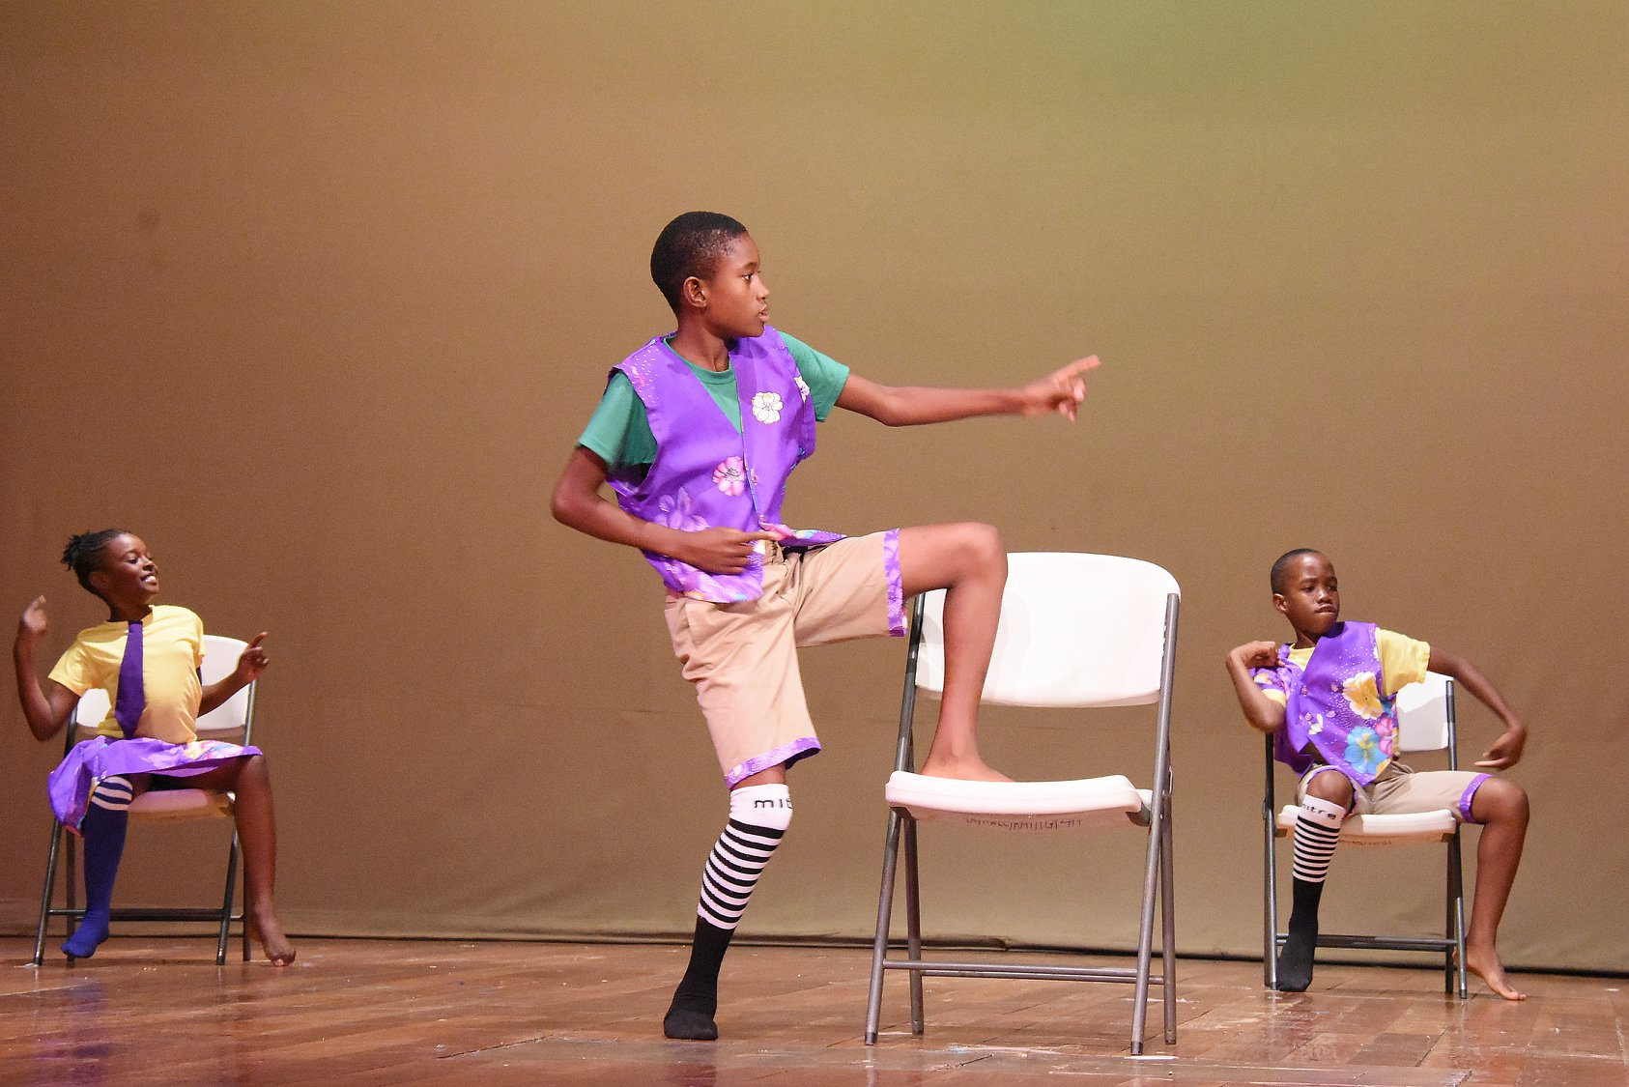
4. Integration in Co & Extra-curricular activities
Annual hosting of Deaf Dance Festival
Students involvement and achievements in the 4H Program,
Optimist International Communication Contest for the Deaf and Hard of Hearing (CCDHH)
Deaf Sports Jamaica
Field Trips

Slide 13
Research Question 2:
What have been Jamaica’s efforts to be more inclusive in the Social Welfare Sector within the past 20 years?

Slide 14
Supportive Programmes & Environments
Programme for the Advancement of Health and Education - PATH
Jamaica Council for Persons with Disabilities - JCPD
National Housing Trust - NHT
Deaf Church & Accessible Churches
Small business loans
“The JCPD (Jamaica Council for Persons with Disabilities) they provided access to the Deaf. They provided us with IDs. We have [to] become members and if you are a member you have access to some discounts provided.”
Notes:
Ministry of Labour and Social Security
PATH Programme
Early Stimulation Programme
Ministry of Health / National Health Fund
GOJ Health Card
Ministry of Housing / National Housing Trust
Housing grants
5% of all housing developments to be set aside for PwDs

Slide 15
2. Increased Deaf Engagement
Youth Parliament
Involvement of Deaf persons in governance contexts
Deaf Youth representation at local and international events
Integrated Sports Day by the Council for Voluntary Social Services (CVSS)
“I have now realised that for the younger Deaf children, they are now being included, meaning that it is not just about the hearing but the Deaf are now [involved] in policies being made.”

Slide 16
3. Communication Access
Interpreting of parliamentary proceedings
Increase in the number of visible interpreters and signers
JSL Classes and advocacy efforts with Deaf tutors
“I have noticed that we have one constant interpreter but it's not much, it’s limited. So like for the Prime Minister or the government, parliament we have limited access to communication.“

Slide 17
Research Question 3:
What have been factors affecting inclusion in the education and social welfare sectors within the past 20 years?

Slide 18
Inadequate Access to Information
Common service providers such as hospitals, hotels, supermarkets, banks, airport, transportation centres, government offices etc., are not positioned to provide full access to information
Inadequate funding and technology (e.g. Closed captioning for news and local programming)
Availability and use of interpreters
Call Helplines vs Text access
Church Involvement

Slide 19
2. Legal Framework
Inadequate “enforced” legislation with clear descriptions and expectations for the Deaf Community
Political Will?
General vs Private Drivers Licence
Deaf Community’s knowledge of current laws that affect their wellbeing

Slide 20
3. Awareness and Attitude toward Deaf Culture
Discrimination and stereotyping
Working with essential service providers
Parents’ and Teachers’ attitude towards JSL and Deaf Culture
Perceptions of Hearing Peers
Government’s approach to provisions for the Deaf Community
Access to national activities such as independence galas, political rallies etc
Low Deaf Friendliess of Companies (<50%); 69% have never employed a Deaf person

Slide 21
“[Grand Gala] I think it's not for me. It is not the place for me because I have no access to communication there. I just sit and just see what's happening. What's the point of going there, if I don’t have an interpreter?”
“ [Sports Events] It is very frustrating for us as Deaf persons, because no interpreters, no communication access.
So yes, we are Deaf but we still need to know what they are saying, what is happening, what is being announced, but because there are no interpreters, it’s creating a problem.”
“The airport does not have boarding zones information on the TV monitors for the Deaf to know when it is time to board. I travel extensively and always find myself needing to either people-watch, those from the same airline check-in line, to know who to follow when it is time”

Slide 22
IN SUMMARY…..
Although there have been attempts over the years, Jamaica is still falling short of being a truly inclusive society.
“ ...The government needs to provide interpreters in the hospital in terms of doctors to make communication access easy because if I have to go to the doctor and I have to write..I don’t have the time.”
“There is no one to enable communication access and make the process easy. You have to write or you just write because there no interpreter there, so how do we get access to communication? so how do we have a full conversation because writing is not enough.”
“Jamaica, despite its efforts to apply inclusion of the Deaf, is not inclusive of the Deaf yet. The lack of interpreting support at public or national events, the lack of communication access at universities, the lack of captioning in movies, and the lack of captioning for toll highways represent a lack of inclusion for the Deaf.”
“...Persons not remembering the key part of Deaf inclusion which is to provide interpreters at all events”

Slide 23
RECOMMENDATIONS
Increased advocacy on the part of the Deaf Community
Public Consultations with Deaf Community
Public Education
JSL competency of staff at public places
Training of Interpreters
Purposeful actions to increase comm access
Enforceable Laws and Policies
GoJ Footing Bill for interpreters in social settings
Closed Captioning for local programs
Revisit how service providers do business with Deaf Persons. Eg. Call numbers, text vs call only.
“I want everything, every inclusion for us, we want to be equal, so if we walk into a hotel, if we go anywhere, technology apps are provided for us, communication access is readily available, signing is provided, and interpreters are provided in every organisation.
For me, I want equality.”

Slide 24
REFERENCES
Canadian Hearing Society. (2013). Challenges affecting the Deaf and Interpreter Communities. Retrieved from
https://www.chs.ca/challenges-affecting-deaf-and-interpreter-communities
Citizens Information Board. (2017). Information provision and access to public and social services for the deaf community. Retrieved from
www.citizensinformationboard.ie/.../Deaf_Community_Research_Rpt_Feb2018.pdf
Deaf British Association. (2014). Accessing public services: Issues for deaf people. Retrieved from https://bda.org.uk/.../BDA_Accessing_Public_Services-Issues_for_Deaf_People-Lond.
Grant, S. (2008). Reaching deaf minds-In the workplace sign’s research into the everyday work experiences of deaf people. Signs Research Report. Retrieved from http://deafinfo.org.uk/policy/RDMITW_Report.pdf
Harvey, E. R. (2008). Deafness: A disability or a difference. Health Law and Policy Brief, 2(1), 42-57. Retrieved from https://digitalcommons.wcl.american.edu/cgi/viewcontent.cgi?referer=https://www.google.com/&httpsredir=1&article=1073&context=hlp

Slide 25
REFERENCES
Naseribooriabadi, T., Sadoughi, F. & Sheikhtaheri, A. (2017) Barriers and facilitators of health literacy among D/deaf individuals: A review article. Iran J Public Health, 46(11), 1465-1474. Retrieved from https://www.google.com/url?sa=t&rct=j&q=&esrc=s&source=web&cd=1&ved=2ahUKEwjziI7vt4fjAhVhxFkKHcwVACUQFjAAegQIAxAB&url=https%3A%2F%2Fwww.ncbi.nlm.nih.gov%2Fpmc%2Farticles%2FPMC5696685%2F&usg=AOvVaw29SSvUG98mEJzKR3cKFa3R
Parks, E., Epely, C. & Parks. J. (2011). A sociolinguistic profile of the Jamaican deaf community. SIL International Electronic Survey Report. Retrieved from https://www.sil.org/system/files/reapdata/15/67/47/156747060387245176234595117050411867142/silesr2011_026.pdf
The Planning Institute of Jamaica. (2015). School-to-work transition of the Deaf in Jamaica. Retrieved from https://www.pioj.gov.jm/Portals/0/Social_Sector/FINAL-DeafStudy-Oct-7-2015(merged%20with%20Deafness%20Terminology).pdf

Slide 26
REFERENCES
The United Nations. (2006). Convention on the Rights of Persons with Disabilities and Optional Protocol.
The United Nations. (2016). Leaving no one behind: The imperative of inclusive development. Report on the World Social Situation 2016. Retrieved from https://www.google.com/url?sa=t&rct=j&q=&esrc=s&source=web&cd=2&cad=rja&uact=8&ved=2ahUKEwjwwJDmrofjAhUF2VkKHadzB98QFjABegQIAhAB&url=https%3A%2F%2Fwww.un.org%2Fdevelopment%2Fdesa%2Fdspd%2Freport-on-the-world-social-situation-rwss-social-policy-and-development-division%2Frwss2016.html&usg=AOvVaw0GHjMOK_aOdjIe4ULfX-Yj
World Federation for the Deaf [n.d.]. Complementary or diametrically opposed: Situating deaf communities within ‘disability’ vs ‘cultural and linguistic minority’ constructs: Position Paper. Retrieved from https://wfdeaf.org/wp.../07/LM-and-D-Discussion-Paper-FINAL-11-May-2018.pdf
World Health Organization. (2011). World Report on Disability 2011. Retrieved from https://www.google.com/url?sa=t&rct=j&q=&esrc=s&source=web&cd=5&ved=2ahUKEwjeiJjzr4fjAhWpxFkKHfNxC8IQFjAEegQIAhAC&url=https%3A%2F%2Fwww.who.int%2Fdisabilities%2Fworld_report%2F2011%2Freport.pdf&usg=AOvVaw2xEwmN7Ae-COE3c5NflN-4

Slide 27
Thank you for your participation!
Any Questions?
Contact us!
ksherlock@jamdeaf.org.jm
dharris@jamdeaf.org.jm
tewen-smith@jamdeaf.org.jm

