Slide 1
Ensuring Inclusion in Schools for the Deaf
Presented at DISES Regional Conference;
Authors: Jessica Scott, PhD, Tisha Ewen-Smith M.Sc, Shauna-kaye McArthur B.A., Iris Soutar, PhD
June 2019
Notes:
My presentation will provide a glimpse into Deaf Education, by sharing about an ongoing three year research that aims to improve inclusion in Schools for the Deaf through the adoption of a bilingual approach

Slide 2
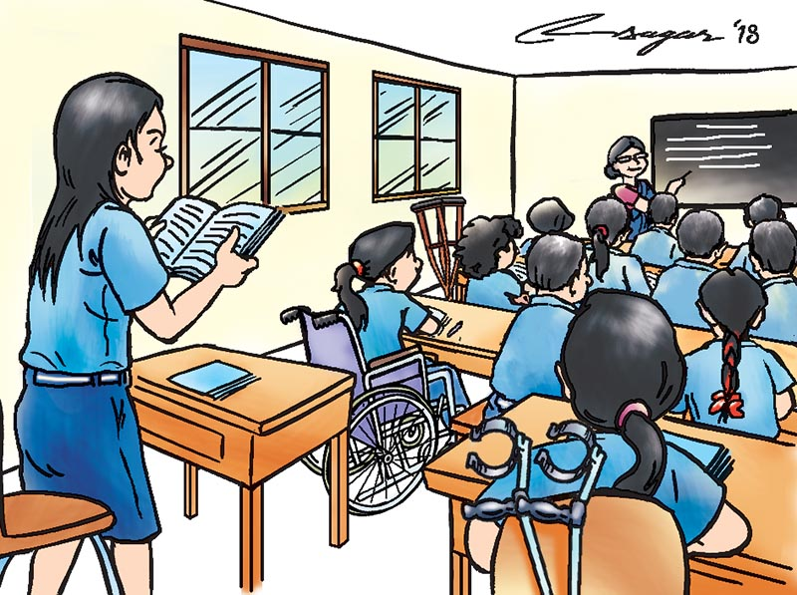
INCLUSION DEFINED (TRADITIONAL)
Inclusive education or inclusion in schools…... all children, irrespective of their intellectual, emotional, social, ethnic, cultural, economic or physical conditions are accommodated and supported for them to achieve “their truest potential” (Wah, 2010)
Notes:
Ask Audience for Feedback

Slide 3
BACKGROUND
Inclusive Education is a growing global practice for most disabilities (Isaac, 2006).
Inconsistent findings on the impact on academic and social development on D/HH students who are mainstreamed.
The language and cultural needs of a D/HH student differ from those of their typical hearing peers.
The mainstream school system would have to provide the necessary services for the Deaf/HH child to be “included” (Canadian Association of the Deaf, 2015)
Notes:
Brice and Strauss (2016) found that there are extensive indications that deaf-specific programs encourage successful socio-emotional growth when compared to mainstream schools.
In a school for the Deaf, Deaf students share a language and a culture, hence they are able to participate in this educational environment equally and naturally. (Canadian Association of the Deaf, 2015)

Slide 4
CURRENT GLOBAL PRACTICES FOR DEAF EDUCATION
Main streaming/Gen Ed
Resource Room or Integrated Unit
Schools for the Deaf
1
2
3
Kreimeyer, Crooke, Drye, Eghert & Klein (2000)

Slide 5
TO MAINSTREAM OR NOT TO MAINSTREAM THE DEAF?
SOCIAL/CULTURAL NEEDS
SCHOOL-WIDE NEEDS
INSTRUCTIONAL NEEDS
Qualified and Trained instructors who are aware of Deaf Culture and utilise a Bilingual approach
Positive teaching and learning environment
Visual access
Trained and Certified Educational Interpreters
Communication Access to support peer relationships
A School Ethos where disabilities are viewed positively and without stigma
Language and Communication Philosophy
JSL Friendly environment and access to information
Infrastructure
Notes:
Issues to be considered
Trained Educational Interpreters for each grade/class/child in relevant content areas
Qualified and Trained instructors and itinerant aware of JSL and Deaf Culture
Bilingual approach as English is not their first language
Teaching and learning environment that promotes two-way communication between student and teacher.

Slide 6
WHAT DOES INCLUSIVE EDUCATION MEAN FOR DEAF AND HARD OF HEARING STUDENTS IN JAMAICA?
Notes:
Fighting for inclusion also involves ensuring that all support systems are available to those who need special support.
Language deprivation is at the heart of the literacy challenges faced by D/HH students.
Our theory of action is premised on a bilingual approach to literacy formation.
We believe that by addressing communication access we will create a more inclusive teaching & learning environment for D/HH students

Slide 7
INCLUSION IN THE CONTEXT OF BILINGUAL DEAF EDUCATION
A shared language philosophy that supports full communication access and cultural identity
Bilingual instructional strategies for Deaf learners
Academic proficiency in JSL for instructional staff and students
Teaching of written English as a second language
A Deaf Friendly School Ethos
Notes:
A truly inclusive educational environment for D/HH students should reflect the following critical features

Slide 8
THE JAMAICAN CONTEXT
In Jamaica, out of a population of about 2.7 million people, approximately 54,000 are Deaf. (The Planning Institute of Jamaica, 2015)
11 Schools for the Deaf serving approximately 400 students
Majority of children who are D/HH are educated in Schools for the Deaf
Undocumented number of children with diagnosed significant hearing loss are currently mainstreamed
Deaf Culture Facilitators (DCFs) used as language and cultural models
Limited cadre of trained and qualified interpreters
Notes:
In Jamaica, out of a population of about 2.7 million people, approximately 54,000 are Deaf. (The Planning Institute of Jamaica, 2015)
11 Schools for the Deaf across six parishes serving approximately 400 students from 1 - 21 years
Majority of children who are D/HH are educated in Schools for the Deaf
Undocumented amount (although it is felt that it may be a few) of children with diagnosed significant hearing loss are currently mainstreamed with little or no support
One integrated unit for the Deaf (excelsior)
An expected high number of undiagnosed children due to stigma, lack of knowledge and resources

Slide 9
Jamaica’s Readiness for Inclusion of the D/HH?
Signatory to the Convention on the Rights of Persons with Disabilities
Draft Special Education Policy
Inadequate:
Infrastructural resources to provide accommodations needed for D/HH students
Pre-service training for Gen Ed Teachers in Deaf Education, Deaf Culture and Jamaican Sign Language at Teachers’ Colleges
Documented guidelines for teachers in the instructional delivery for D/HH Students
Scott, Dostal & Ewen-Smith, 2019: Inclusion and exclusion: Global challenges within deaf education in: B. Rice & A. Threlkeld (Eds.), Global Perspectives on Inclusive Teacher Education

Slide 10
Jamaica’s Readiness for Inclusion?
What is still needed?
Cadre of trained and certified interpreters to service educational institutions (inadequate local training of such interpreters)
Enhanced positive perspective and understanding about Disabilities especially Deafness and Deaf Culture
Trained teachers equipped to serve D/HH students

Slide 11
ABOUT THE PARTNERSHIP FOR LITERACY ENHANCEMENT FOR THE DEAF PROJECT
Jamaican Sign Language Grammar Curriculum
Parent Training in JSL -> Ensuring the home environment is inclusive for the Deaf/HH child
Teacher Training in JSL and Bilingual Techniques
School Leaders Capacity Building
Notes:
Language Rich Environment

Slide 12
RESEARCH QUESTIONS
How is inclusion defined for schools for the Deaf in Jamaica?
What does inclusivity in schools for the Deaf look like via the PLED Project?
How do DCFs perceive their roles in supporting inclusive environments in Schools for the Deaf?
Notes:
A focused measure of the impact of the PLED Project to improve inclusion in Schools for the Deaf
If you view inclusion as the problem being addressed by this research then these 3 questions will allow you to share critical information.
#1 requires you to share the process and output of creating a a language philosophy to govern inclusion in the schools, because a bilingual approach is considered to be at the core of the solution.
#2 The effectiveness of the PLED interventions lie in the cultivation of: (A) a bilingual environment marked by a) strong JSL communicative competence among key players b) bilingual instructional strategies and (B) its impact evident in students' literacy performance.
#3 Focuses on the role of DCFs as language and cultural model in the design, development and delivery stages of intervention.

Slide 13
RESEARCH DESIGN & METHODS
A Descriptive Research Design
Mixed Methods
Focus Groups
Multiple Case Studies
Surveys
Performance Assessment
Notes:
A descriptive research design, incorporating both qualitative and quantitative data collection methods.
Based on Bilingual theory, the research aims to provide insights into why and how a bilingual approach to Deaf education assures inclusion in Schools for the Deaf
The Focus is on instructional practices for literacy formation - examining the impact of including JSL Grammar study as part of Language Arts in an effort to cultivate a stronger foundation in JSL to support teaching English as a second language
I would describe our approach as a mixed method Descriptive Research design. Our methodology included Focus group discussions with Principals/school administrators to define our brand of inclusion; Case Study classes for piloting the curriculum, attitude surveys and competency/performance monitoring tests with students and teachers.

Slide 14
PARTICIPANTS IN THE RESEARCH
A Purposive Sample of 10 Pilot Classes to include:
11 teachers across 8 school sites
In-depth assessment of 56 students
121 Teachers and Deaf Culture Facilitators
100 Parents and Family Members
15 Instructional leaders/Senior Teachers of participating schools
Notes:
Pilot Classes were exposed to a guided delivery of the JSLGC Level 1
Teachers and DCF received training in bilingual instructional strategies
Training for improved JSL proficiency offered to instructors
Parents exposed to JSL and training to support literacy development
Educational leaders guided to formulate a language philosophy to guide the cultivation of a more inclusive educational environment

Slide 15
Data Collection and Analysis
Comparative surveys of perceptions of JSL and Deaf Culture
Comparison of Pre and Post student performance on select literacy components:
Reading Comprehension
Vocabulary development
Understanding of Sentence Components in JSL
Production of complete ideas in JSL
Production of complete ideas in written English

Slide 16
Research Question 1: Re-defining Inclusion
Language Philosophy
“To create a bilingual environment where all students should have equal access to communication through Jamaican Sign Language and written English to develop a positive self-concept and promote excellence”
Notes:
Describe the Focus Group discussions that produced this shared philosophy

Slide 17
Research Question #2: PLED Interventions
Baseline Results: Production of Complete Ideas in Written English
# of Students | Grade Level | Sentence Production Rate | % Complete Ideas | Major Challenges
8 | Grades 1-2 | 0 | 0% | Lack of basic language and pre-writing skills
17 | Grades 4-5 | 7 | 48% | Limited vocabulary Translation skills Low interest or fear of writing
23 | Grades 7-9 | 9 | 63%
4 | Grades 10-12 | 10 | 46%
Notes:
Work in Progress. Half way thru longitudinal studies

Slide 18
JSL & DEAF CULTURE SURVEY RESULTS 2017
AMONG PERSONNEL IN SCHOOLS FOR THE DEAF
35% believed Signed English more valuable in developing literacy
59% confident in the value of JSL to assure exam success
40% believing in SEE and a High level of uncertainty
75% convicted of JSL providing communication access
Notes:
35% believed Signed English more valuable in developing literacy
59% confident in the value of JSL to assure exam success
40% believing in SEE and a High level of uncertainty
75% convicted of JSL providing communication access
A context of persons needing to be convinced of the value of JSL and the bilingual approach

Slide 19
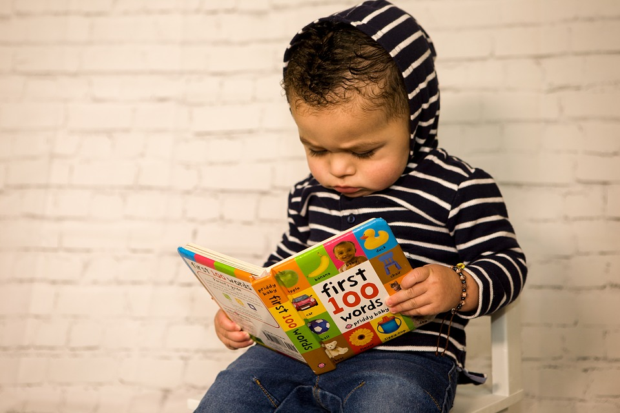
STUDENTS’ READING COMPREHENSION
5% of student cohort functioning at or above grade level at baseline (2017).
1% increase at the end of the first year.
47% of sample progressed between 1-6 grade levels over the previous academic year; Increased to 56% in the last year.

Slide 20
Training for Teachers and DCFs
106 or 88% of academic staff trained up to JSL L2;
79% trained in JSL Level 3
All Grades 1 and 2 teachers trained in bilingual techniques
Model Classroom established at each school to demonstrate effective bilingual strategies

Slide 21
Results: Parents JSL Training and Self Reports:
Survey Item (Self Reports) | BEFORE | AFTER | % Change
How often did you use JSL when communicating with your Child? | 25% | 38% | 13%
Did you feel more confident using JSL to communicate with your child? | 53% | 73% | 20%
How often did you help your child with homework? | 63% | 67% | 4%
How often did you read with your child? | 14% | 29% | 15%
47% of parents obtaining satisfactory results in JSL Training

Slide 22
Research Question #3: DCFs support for Inclusion
Who are Deaf Culture Facilitators? Approved MoEYI positions who serve as language and cultural models within schools for the Deaf
Provide significant support to hearing teachers in the preparation and delivery of subject content
Support acquisition of Jamaican Sign Language
Positioned within the earlier grades for enhanced impact on language development
Delivers the JSL Grammar Curriculum
Notes:
Approved positions by the MoEYI
Serve as language and cultural models within schools for the Deaf
Provide significant support to hearing teachers in the preparation and delivery of subject content
Support new D/HH students in the acquisition of Jamaican Sign Language
Not just a Teacher’s Aide
Positioned within the earlier grades for enhanced impact on language development
Delivers the JSL Grammar Curriculum

Slide 23
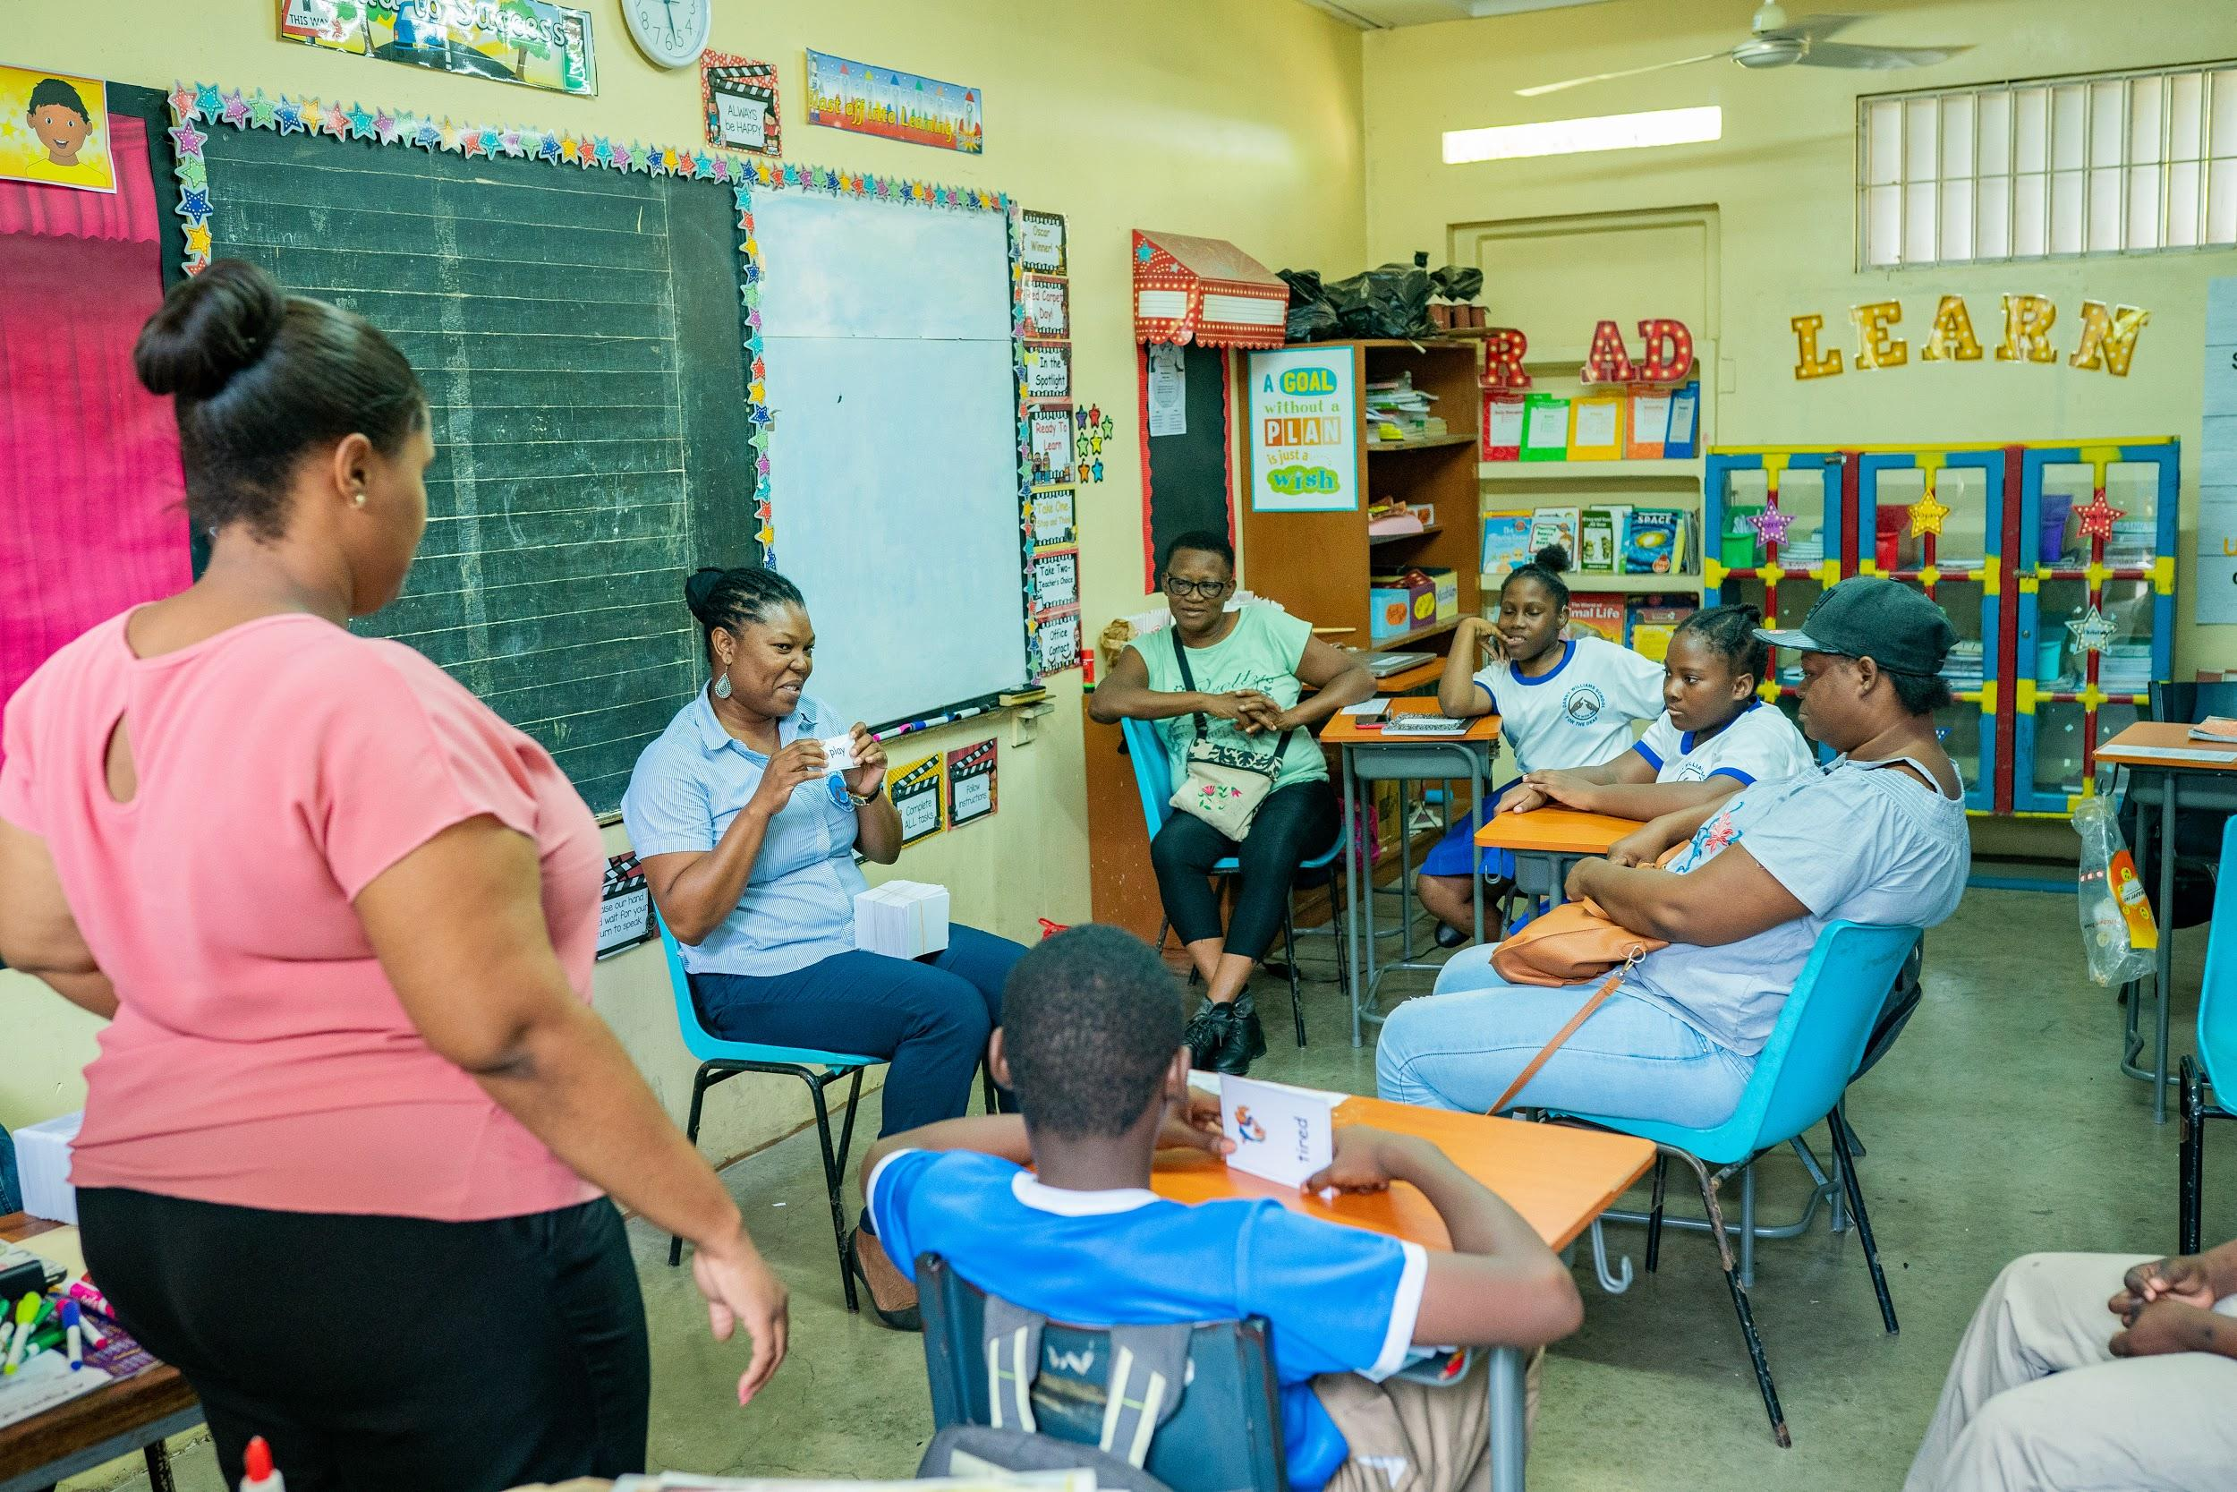
HOW DO DCFS REPORT THEIR ROLES: Working with Parents
Students and parents’ workshops to help them understand the Language and the needs of their Deaf children. Communication is necessary.
Teach them Sign Language and Shared Reading
Training in JSL vocabulary, spelling, writing and how to help their children with homework.
“...we don’t leave them on their own”
Notes:
We’ve had students and parents’ workshops, we’ve had one-on-one; we’ve invited them to the classroom to help them understand the Language and the needs of their Deaf children. Communication is necessary.
We show them the resources that they can use, and we provide training. We teach them Sign Language, we teach them vocabulary, spelling, writing, how to help their children with homework. So, we provide new ideas for the parents to help their child. We don’t leave them on their own. We do follow-up, we do one-on-ne and the parents are now more interested in teaching their child; they are more confident. They are now helping them with homework. We formed WhatsApp groups where we collaborate. We share the homework, here. If the parents don’t understand we do video calls to show them the sign.
We use shared reading, also.

Slide 24
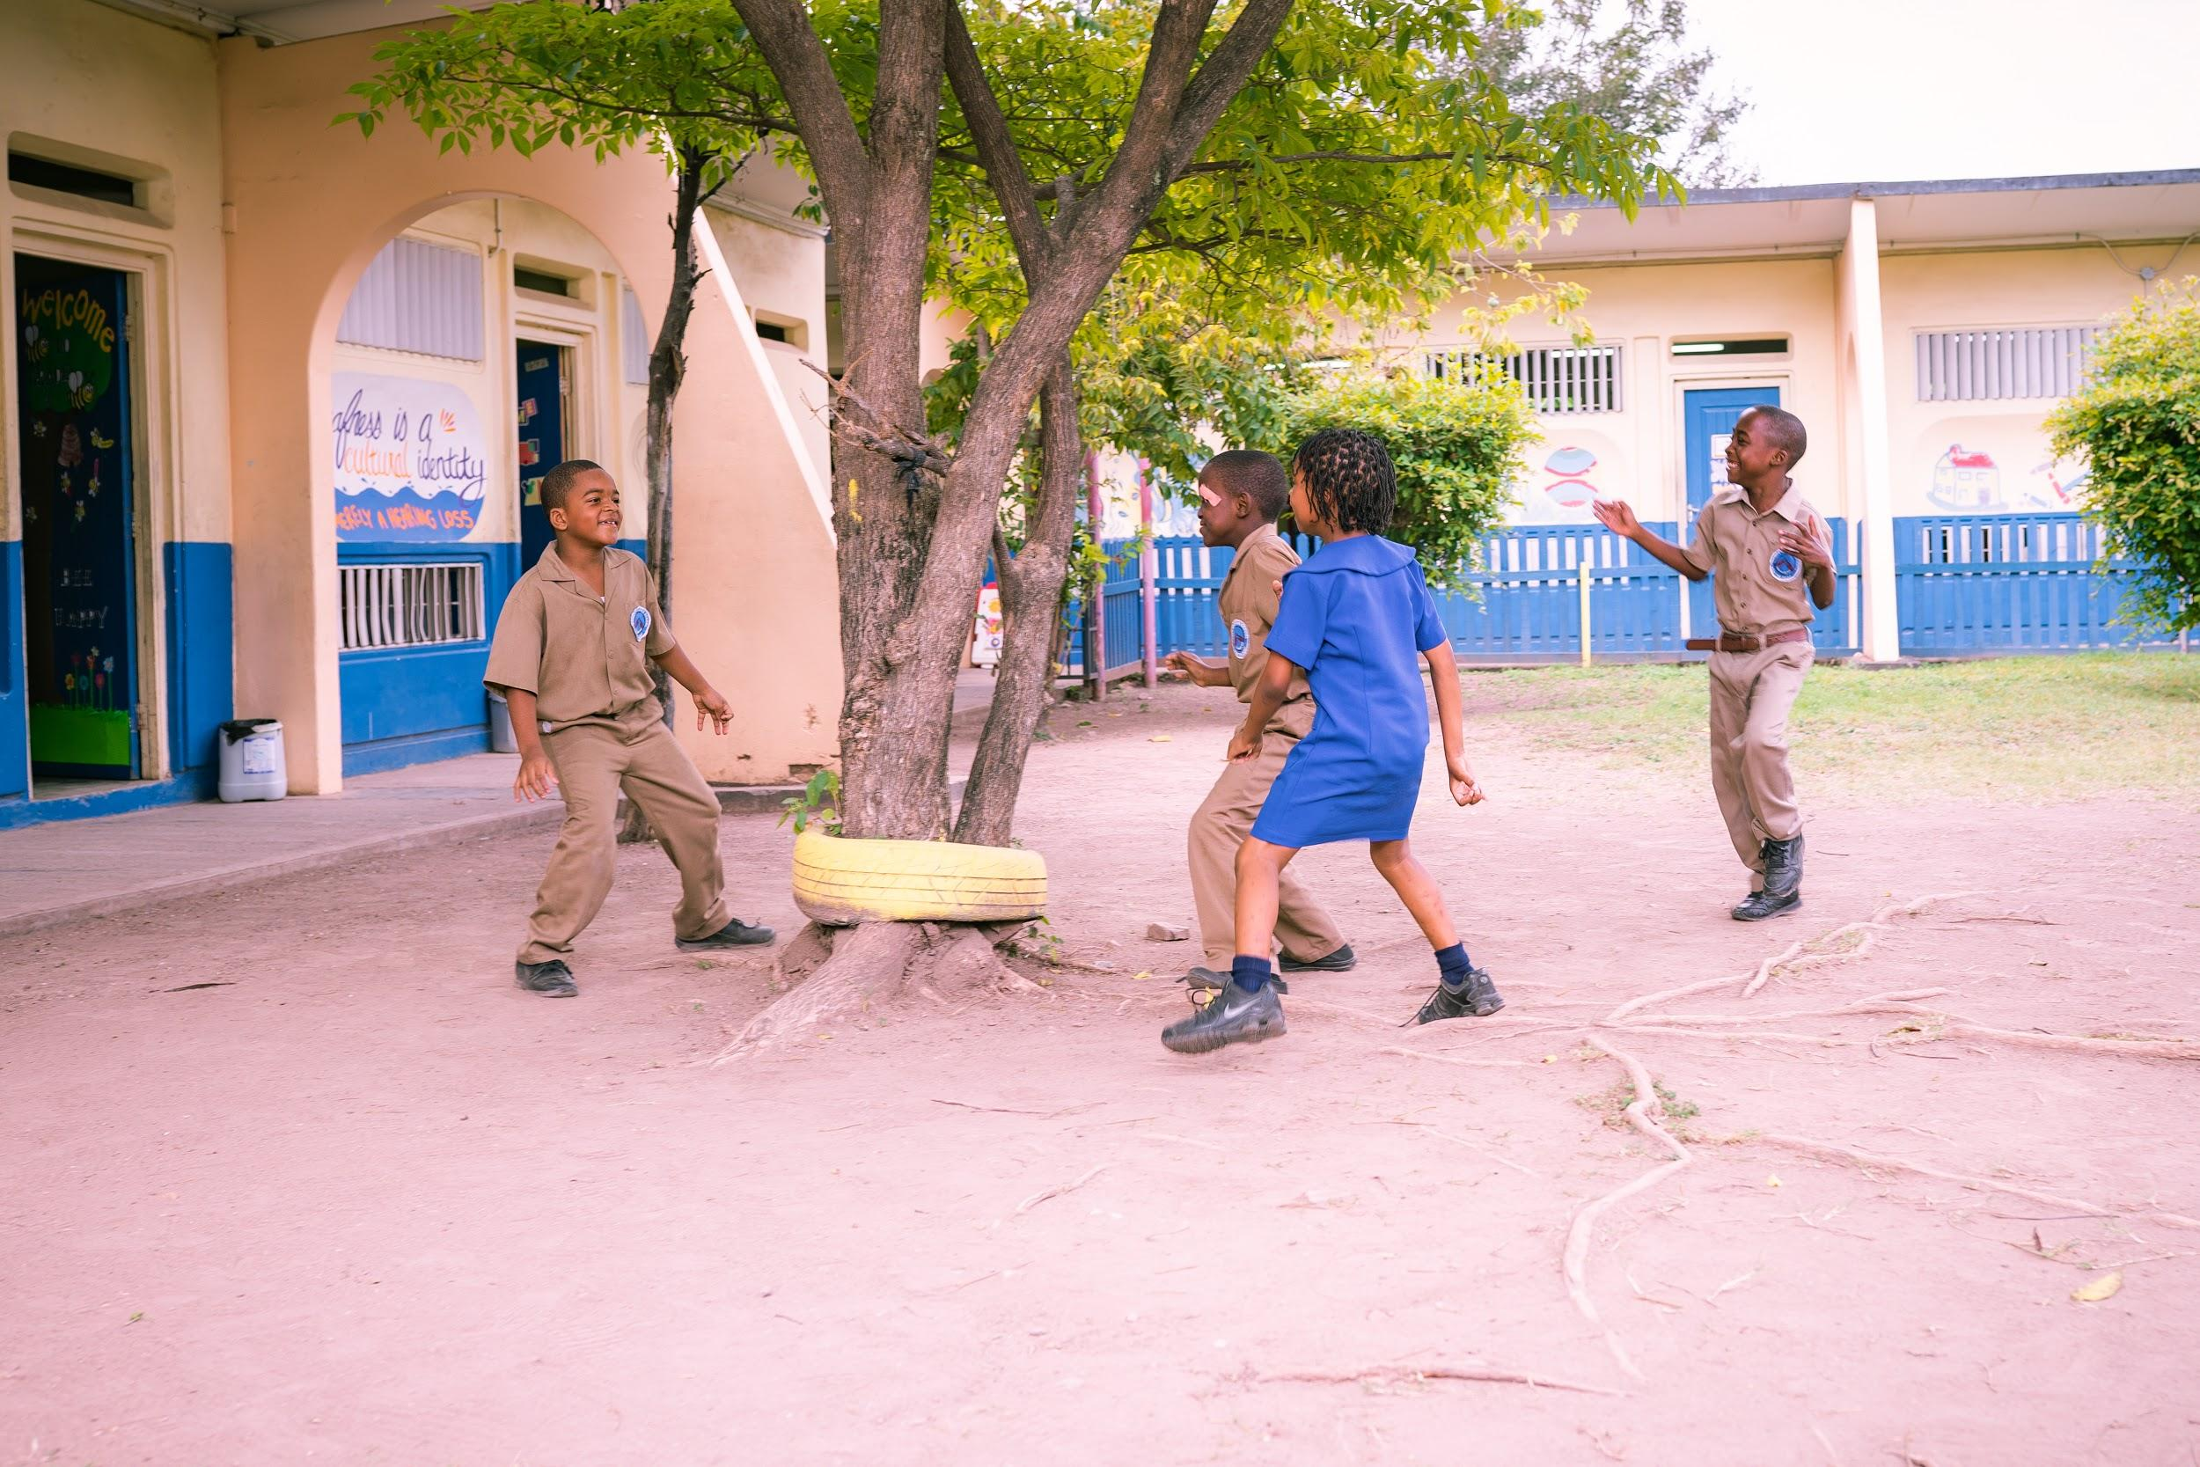
HOW DO DCFS REPORT THEIR ROLES
Responsible for Passing on the Language and Cultural Legacy:
I believe I have a role because I am also Deaf.
I am a role model to them, and I want my legacy to be passed on to them.
Giving them a language and teaching them the culture which is very valuable. I am teaching them to respect and appreciate their Language and keep on passing it to generations to come.
...to make sure that the students have their first language which is Sign Language
The children were not given the opportunity to have that kind of conversation/information at home due to lack of communication
Notes:
We’ve had students and parents’ workshops, we’ve had one-on-one; we’ve invited them to the classroom to help them understand the Language and the needs of their Deaf children. Communication is necessary.
We show them the resources that they can use, and we provide training. We teach them Sign Language, we teach them vocabulary, spelling, writing, how to help their children with homework. So, we provide new ideas for the parents to help their child. We don’t leave them on their own. We do follow-up, we do one-on-ne and the parents are now more interested in teaching their child; they are more confident. They are now helping them with homework. We formed WhatsApp groups where we collaborate. We share the homework, here. If the parents don’t understand we do video calls to show them the sign.
We use shared reading, also.

Slide 25
SUMMARY OF PROGRESS
Pilot of JSL Grammar Curriculum
47% of sample progressed between 1-6 grade levels in reading comprehension over the previous academic year; Increased to 56% in the last year
Improvements in Parents JSL - Attitudes and Practices
106 or 88% of academic staff trained up to JSL L2; 79% trained in JSL Level 3 (JSL L1-4)
DCFs perceive their role to be critical to identity and language development of D/HH students

Slide 26
FEEDBACK FROM PARTICIPANTS
For years I have struggled to understand how to apply bilingual strategies to enrich my lessons and now finally the project has exposed me on how to make that a reality.
Now I understand, I feel like I can connect with her more.
The students are more aware of their language and eager to use it, they are learning.
The students feel that their language has a place in the classroom not only on the playfield or social settings.
There is a greater sense of pride, freedom of expression, feeling of being understood and belonging

Slide 27
RECOMMENDED FRAMEWORK FOR AN INCLUSIVE APPROACH TO DEAF EDUCATION
Ensuring full communication access via a full bilingual approach
Teaching of JSL as a curriculum subject
Respect for Deaf culture
Purposeful inclusion of Deaf in the instruction of D/HH Students. For e.g. Presence of language and cultural models
All instructors competent in JSL
Deaf Friendly school ethos
Supportive Family Environment

Slide 28
CONCLUSION
Given the local context and the specific cultural, linguistic, and academic needs of D/hh students, a more deaf-centric approach where inclusion considers how deaf education classrooms may include accessible language, the Deaf community, families of D/hh children, and Deaf role models may be more appropriate for this population (Scott et al, 2019)
Given the extensive capital outlay required for mainstreaming D/HH students, focus should be on a paradigm shift towards ensuring schools for the Deaf provide a truly inclusive environment for the D/HH
Use of Language and Cultural models to support instructional delivery, cultural identity and social development of D/hh students is paramount

Slide 29
RECOMMENDATIONS AND NEXT STEPS
Further research with exploration within the local context on
Comparing academic results from both GenEd vs Self-contained;
Role and impact of the degree of hearing loss, age and educational level
Considerations for more specific mention in current draft Special Education Policy
Licensure requirements for Teachers of the Deaf

Slide 30
RECOMMENDATIONS AND NEXT STEPS
Revisit the GoJ’s budgetary allocation/provisions
Allocations for more DCFs by MoEYI
Adjustment to the qualifications requirement and training opportunities for DCFs
Interpreter Training to support out of school communication needs
Inclusion of Special Education training for all teachers during pre-service training

Slide 31
REFERENCES
Andrews, J. (2017). Bilingual/Bicultural education in Latin America. The Journal of Deaf Studies and Deaf Education, 22(3), 346–347.`https://doi.org/10.1093/deafed/enx004
Brice, P. J. & Strauss, G. (2016). Deaf adolescence in a hearing world: a review of factors affecting psychosocial adaptation. Dove Press Journal: Adolescence Health, Medicine and Therapeutics, 7, 67-76. Retrieved from https://www.ncbi.nlm.nih.gov/pmc/articles/PMC4847601/
Canadian Association of the Deaf. (2015). Retrieved from http://cad.ca/issues- positions/education/
Cosier, M., Causton-Theoharis, J. & Theoharis, G. (2013). Does access matter? Time in general education and achievement with disabilities. Remedial and Special Education. Retrieved from https://journals.sagepub.com/doi/abs/10.1177/0741932513485448
Dammeyer, J., and Marschark, M. (2016). Level of educational attainment among deaf adults who attended bilingual-bicultural programs. Journal of Deaf Studies and Deaf Education, 21 (4), 394-402. https://doi.org/10.1093/deafed/enw036

Slide 32
REFERENCES
Dessemontet, R. S., Bless, G. & Morin, D. (2011). Effects of inclusion on the academic achievement and adaptive behaviour of children with intellectual disabilities. Journal of Intellectual Disability Research. Retrieved from https://onlinelibrary.wiley.com/doi/abs/10.1111/j.1365-2788.2011.01497.x
Hiebert, N. R. (2019). Experiences of social inclusion and exclusion of Deaf children (Master’s Thesis, Western University). Retrieved from https://ir.lib.uwo.ca/etd/6053/
Isaacs, R. (2007). What are the factors influencing successful inclusion of deaf children? (Master’s Thesis, Roehampton University). Retrieved from https://is.cuni.cz/webapps/zzp/download/120150590
Kreimeyer, K.H., Crooke, P., Drye, C., Eghert. W., & Klein, B. (2000). Academic and Social Benefits of a Co-enrollment model of Inclusive Education for the Deaf and Hard of Hearing Children
Office of the United Nations High Commissioner Human Rights. (2013). Thematic study on the right of persons with disabilities to education. Retrieved from https://www.ohchr.org/EN/Issues/Disability/Pages/StudyRightOfPersonsWithDisabilitiesToEducation.aspx

Slide 33
REFERENCES
Scott, J., Dostal, H.M. & Ewen-Smith, T. (2019). Inclusion and exclusion: Global challenges within deaf education. In B. Rice & A.
Threlkeld (Eds.), Global perspectives on inclusive teacher education (pp 120-136). USA: IGI Global
Tuggar, A. M. (2014). Benefits of inclusive to the education of special needs children. National Journal of Inclusive Education, 2(1), 106-109. Retrieved from http://irepos.unijos.edu.ng/jspui/bitstream/123456789/1652/1/benefits%20of%20inclusive%20education.pdf
Wah, L. L., (2010). Different strategies for embracing inclusive education: A snapshot of individual cases from three countries. International Journal of Special Education, 25(3), 98-109. Retrieved from https://eric.ed.gov/?id=EJ909040
Xie, Y., Potměšil, M., & Peters, B. (2014). Children who are deaf or hard-of- hearing in inclusive educational settings: A literature review on interactions with peers. Journal of Deaf Studies and Education, 19(4), 423-437. Retrieved from https://academic.oup.com/jdsde

Slide 34
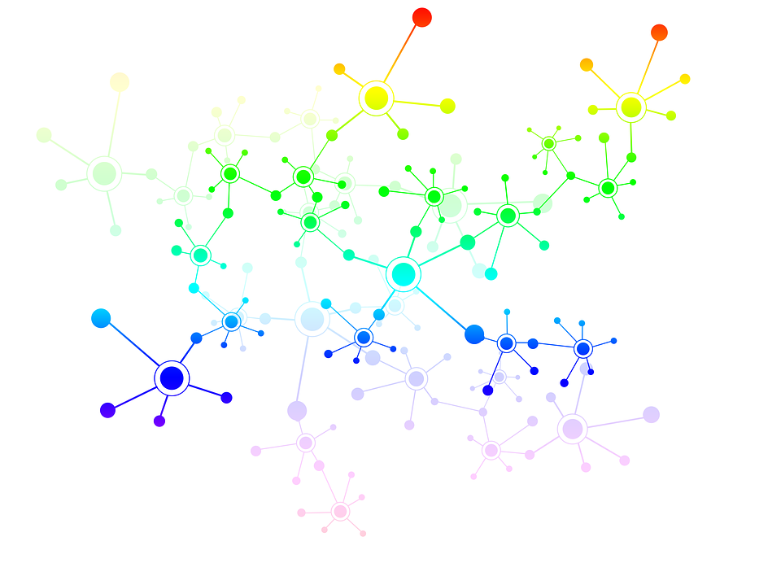
Thank you for your participation!
Any Questions?
Let us meet at the break so we can network!
tewen-smith@jamdeaf.org.jm
876-295-6782

